Slide 1
LAYER 1/2 CONNECTIVITY: WIRELESS TECHNOLOGIES FOR THE IoT, LAYER 3 CONNECTIVITY: IPv6 TECHNOLOGIES FOR THE IoT
Module-3

Slide 2
Books Referred
Daniel Minoli, ”Building the Internet of Things with IPv6 and MIPv6:The Evolving World of M2M Communications”, Wiley, 2013.

Slide 3
Layer ½ Connectivity: Wireless Technologies for the IoT

Slide 4
Overview
Basic lower-layer wireless technologies to support IoT/machine-to-machine (M2M) applications, as it appears that many such implementations will entail wireless connectivity at the PHY/MAC layer.

Slide 5
Overview
Available wireless networks that can be utilized for IoT/M2M applications include the following:
Personal area networks (PANs): Zigbee R, Bluetooth R, especially Bluetooth low energy (BLE), near field communications (NFC), and proprietary systems (e.g., ANT+,2 NIKE+3); specifically, there is interest in low-power wireless personal area networks (LoWPANs); some of these PANs are also classified as low-rate wireless personal area networks (LR-WPANs).
Wireless local area networks (WLANs):Wi-Fi R IEEE Standard 802.11 (including vendor-specific implementations for low power4);
Metropolitan area networks (MANs): WiMAX;
Wireless sensor networks (WSN): application-specific technology;
Third generation (3G)/4G cellular: Universal mobile telecommunications system (UMTS), general packet radio service (GPRS), enhanced data rates (EDRs) for GSM evolution (EDGE), and long-term evolution (LTE);
Global: Satellite networks.

Slide 6
Overview
IoT/M2M connectivity using wired means,
For example power line communication (PLC)-based grid management.
supervisory control and data acquisition (SCADA)-based systems to enable remote telemetry functions in the power grid

Slide 7
WPAN Technologies for IoT/M2M
A PAN (also called WPAN) is a network used for communication with devices which are physically close to a person (includes smartphones, tablets, body monitors, and so on).
PANs can be used to support wireless body area networks (WBANs)/ wireless medical body area networks [WMBANs] and/or medical body area network systems [MBANSs]).

Slide 8
WPAN Technologies for IoT/M2M
Medical applications include, among others, vital sign monitoring, respiration monitoring, electrocardiography (ECG), pH monitoring, glucose monitoring, disability assistance, muscle tension monitoring, and artificial limb support.
Nonmedical applications of WBANs include, among others, video streaming, data transfer, and entertainment and gaming.
The reach of a PAN is typically a few meters. The devices is known as short range devices (SRDs).
PANs can be used for communication among the personal devices themselves (intrapersonal communication), or for connecting to a higher level network such as the Internet.

Slide 9
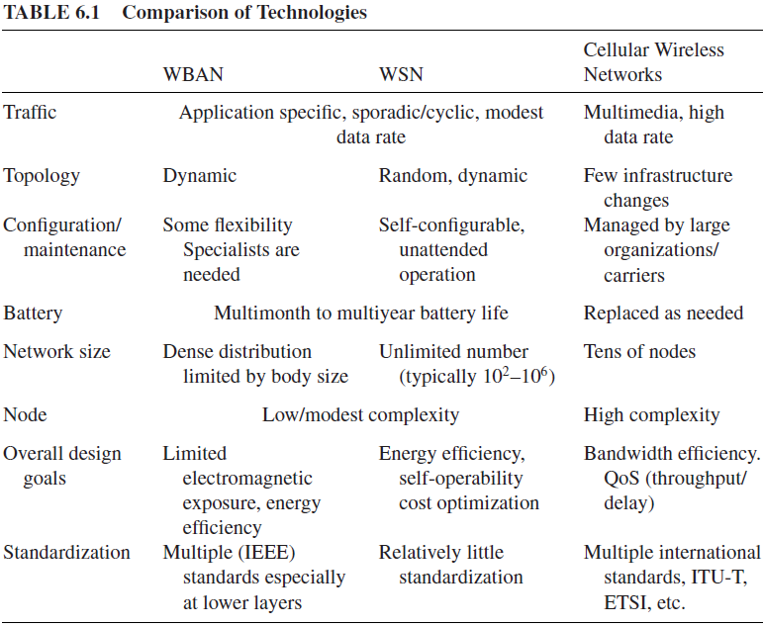
WPAN Technologies for IoT/M2M

Slide 10
WPAN Technologies for IoT/M2M
The WBAN technologies can satisfy, major requirements that the healthcare industry considers important:
(i) very low-power sensor consumption,
(ii) very low transmitted power,
(iii) high reliability and quality of service (QoS).

Slide 11
WPAN Technologies for IoT/M2M
WBANs, the key wireless standards include ZigBee/IEEE 802.15.4 along with the Personal, Home and Hospital Care (PHHC)
ZigBee Health Care,
IEEE 802.15.1 (Bluetooth),
IEEE 802.15.6 and IEEE 802.15.4j;
ISO/IEEE 11073 and ETSI TR 101 557 V1.1.1
Low-power consumption IEEE 802.11 Wi-Fi

Slide 12
WPAN Technologies for IoT/M2M
The following network topologies are applicable to personal low-power radio networks:
Broadcast: environment where a message is sent from a device in the hope that it is received by a receiver within range. The broadcaster does not receive signals;
Mesh: environment where a message can be relayed from one point in a network to any other by hopping through multiple nodes;
Star: environment where a central device can communicate with a number of connected devices;
Scanning: environment where a scanning device is constantly in receive mode, waiting to pick up a signal from anything transmitting within range;
Point-to-point: in this mode, a one-to-one connection exists, where only two devices are connected over the communication path.

Slide 13
WPAN Technologies for IoT/M2M
Zigbee/IEEE 802.15.4
Radio Frequency for Consumer Electronics (RF4CE)
Bluetooth and its Low-Energy Profile
IEEE 802.15.6 WBANs
IEEE 802.15 WPAN TG4j MBANs
ETSI TR 101 557
NFC
Dedicated Short-Range Communications (DSRC) and Related Protocols
Comparison of WPAN Technologies

Slide 14
WPAN Technologies for IoT/M2M Zigbee/IEEE 802.15.4
The commercialization of consumer-based IoT services requires the introduction of wireless, low-power, battery-powered sensors and actuators in people’s premises.
ZigBee’s focus aimed at the “little devices” (things, objects) like light switches, thermostats, electricity meters, remote controls (RCs), as well as more complex sensor devices found in the healthcare, commercial building, and industrial automation sectors.
To avoid multiple separate consumer networks, a PHY/MAC-agnostic solution is needed upon which IP standards and other well-known higher-layer protocols can run with little changes.
ZigBee is one such open standard, as discussed below. ZigBee IP (ZIP) is an example where Zigbee systems operate in an IP context.
Here we focus more on the wireless lower-layer aspects of Zigbee and not the IP part.

Slide 15
WPAN Technologies for IoT/M2M Zigbee/IEEE 802.15.4
ZigBee utilizes the globally available, license-free 2.4 GHz industrial, scientific, and medical (ISM) frequency band to provide low data rate wireless applications
IEEE 802.15.4, wireless links can operate in three unlicensed frequency bands, namely the 858 MHz band, the 902-to-928 MHz band, and the 2.4 GHz band
IEEE 802.15.4 defines a robust radio PHY (physical) layer and MAC (medium access control) layer, while ZigBee defines the network, security, and application framework for an IEEE 802.15.4-based system.

Slide 16
WPAN Technologies for IoT/M2M Zigbee/IEEE 802.15.4
ZigBee networks support star, mesh, and cluster-tree topologies.
These capabilities enable a network to have over 65,000 devices on a single wireless network.
ZigBee offers low-latency communication between devices without the need for the initial network synchronization delays as required by Bluetooth.
ZigBee can create robust self-forming, self-healing wireless mesh networks. The ZigBee mesh network connects sensors and controllers without being restricted by distance or range limitations;
ZigBee mesh networks allow all participating devices to communicate with one another and act as repeaters transferring data between devices.

Slide 17
WPAN Technologies for IoT/M2M Zigbee/IEEE 802.15.4
ZigBee is available as two feature sets,
ZigBee PRO and ZigBee.
Both feature sets define how the ZigBee mesh networks operate.
ZigBee PRO, the most widely used and optimized for low-power consumption and to support large networks with thousands of devices.
The ZigBee Alliance announced an expanded set of features for the ZigBee protocol.
This new stack profile is universally referred to as ZigBee PRO and for the most part defines specific stack settings and makes mandatory many of the features.
ZigBee PRO also used in some new application like automatic meter reading, commercial building automation, and home automation.

Slide 18
WPAN Technologies for IoT/M2M Zigbee/IEEE 802.15.4
ZigBee PRO features implement support for larger networks,
for example stochastic addressing to assign addresses using probability analysis to simplify network formation.
ZigBee PRO implements a technique known as frequency agility (not hopping):
a network node is able to scan for clear spectrum (with a choice of 16 available channels) and communicate its findings back to the ZigBee coordinator so that a new channel can be used across the network.
ZigBee PRO networks have the ability to aggregate routes through the use of “many-to-one” routing;
this allows each device to share the same routing path reducing broadcast and network traffic and greatly improves the efficiency and stability of the network routing table.

Slide 19
WPAN Technologies for IoT/M2M Zigbee/IEEE 802.15.4
The ZigBee 802.15.4 spec defines a maximum packet size of 128 octets;
this packet size is optimal for short control messages, but there may be instances where the network needs to send larger messages;
therefore, ZigBee PRO now has the means to automatically fragment and reassemble a message at a receiving node relieving the host application of this overhead.
The ZigBee Alliance is a global ecosystem of 400+ companies in the M2M/IoT space developing standards and producing products for use in commercial building automation, consumer electronics, health care and fitness, home automation, energy management, retail management, and wireless telecommunications.

Slide 20
WPAN Technologies for IoT/M2M Zigbee/IEEE 802.15.4
LR-WPANs (Low-Rate Wireless Personal Area Networks) applications require a low-cost, small-size, highly reliable technology which offers long battery life, measured in months or even years, and automatic or semiautomatic installation.
ZigBee is a low-power wireless specification that introduces mesh networking to the low-power wireless space and is targeted toward applications such as smart meters, home automation, and RC units. ZigBee technology provides reasonably efficient low-power connectivity and ability to connect a large number of devices into a single network.
Some studies have shown that for the home, two wireless PHY layer communications technologies that best meet the overall
performance and cost requirements are Wi-Fi (802.11/n) and ZigBee (802.15.4).

Slide 21
WPAN Technologies for IoT/M2M Zigbee/IEEE 802.15.4
Disadvantages:
ZigBee’s relative complexity (as seen in the protocol stack) and the apparent fact that the power consumption of ZigBee devices is higher than the consumption of some alternatives (e.g., BLE) tend to make ZigBee not always the most ideal solution for unmaintained devices that need to operate for extensive periods of time from a limited power source;
hence, while many home applications make ideal use of ZigBee, other IoT/M2M applications can also be supported by other approaches.

Slide 22
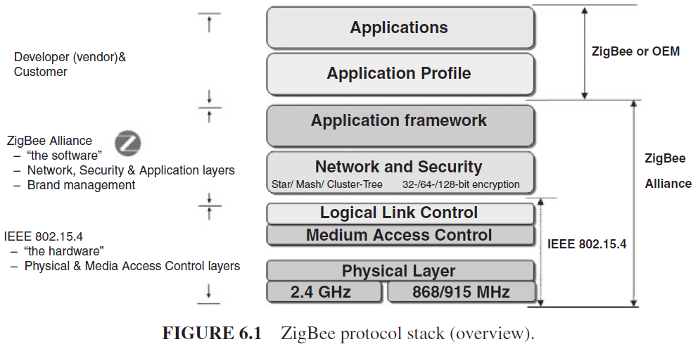
WPAN Technologies for IoT/M2M Zigbee/IEEE 802.15.4
ZigBee makes use of the physical radio specified by IEEE 802.15.4; it adds logical network capabilities, and security and application software.

Slide 23
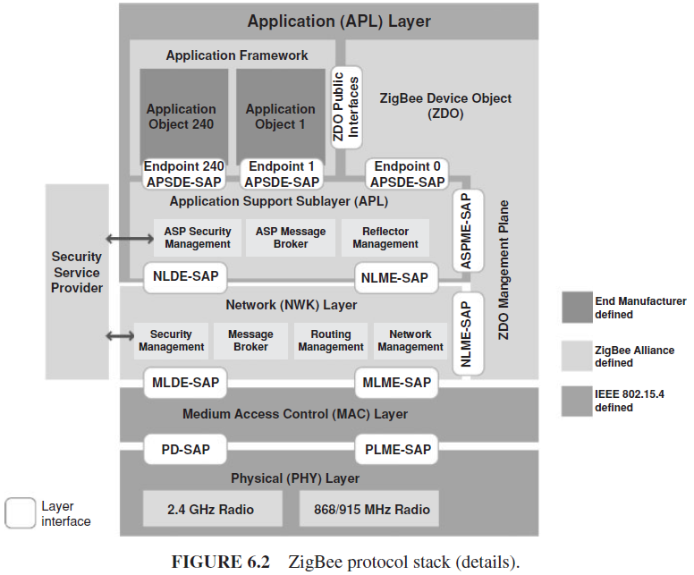
WPAN Technologies for IoT/M2M Zigbee/IEEE 802.15.4

Slide 24
WPAN Technologies for IoT/M2M Zigbee/IEEE 802.15.4
The PHY layer of the reference model specifies the network interface components, parameters, and operation.
The PHY layer includes a variety of features, such as
receiver energy detection (RED),
link quality indicator (LQI),
clear channel assessment (CCA).
The PHY layer is also including low-duty cycle operations, strict power management, and low transmission overhead.
IEEE 802.15.4 defines several addressing modes:
it allows the use of either IEEE 64-bit extended addresses or 16-bit addresses unique within the PAN.

Slide 25
WPAN Technologies for IoT/M2M Zigbee/IEEE 802.15.4
MAC layer handles network association and disassociation.
It also regulates access to the medium; this is achieved through two modes of operation:
beaconing
nonbeaconing.
The beaconing mode is specified for environments where control and data forwarding is achieved by an always active device.
The nonbeaconing mode specifies the use of unslotted, non persistent CSMA-based MAC protocol.

Slide 26
WPAN Technologies for IoT/M2M Zigbee/IEEE 802.15.4
The network layer provides the functionality required to support network routing capabilities, configuration and device discovery, association and disassociation, topology management, MAC layer management, and routing and security management.
Three network topologies, namely star, mesh, and cluster tree, are supported.

Slide 27
WPAN Technologies for IoT/M2M Zigbee/IEEE 802.15.4
The security layer leverages the basic security services specified by the IEEE 802.15.4 security model to provide support for infrastructure security and application data security.

Slide 28
WPAN Technologies for IoT/M2M Zigbee/IEEE 802.15.4
The application layer consists of the application support sublayer (APS), the ZigBee device object (ZDO), and the manufacturer-defined application objects.
The responsibilities of the APS sublayer include maintaining tables for binding devices together, based on their services and their needs, and forwarding messages between bound devices.

Slide 29
WPAN Technologies for IoT/M2M Zigbee/IEEE 802.15.4
ZigBee is not a frequency-hopping technology; therefore, it requires careful planning during deployment in order to ensure that there are no interfering signals in the vicinity.
The design of the PHY layer is driven by the need for low-cost, power-effective PHY layer for cost-sensitive, low data rate monitoring and control applications.
Under IEEE 802.15.4, wireless links can operate in three unlicensed frequency bands, namely in the 858 MHz band, in the 902-to-928 MHz band, and in the 2.4 GHz band.
Based on these frequency bands, the IEEE 802.15.4 standard defines three physical media:
Direct sequence spread spectrum (DSSS) using binary phase shift keying (BPSK), operating in the 868 MHz at a data rate of 20 Kbps;
DSSS using BPSK, operating in the 915 MHz at a data rate of 40 Kbps
DSSS using offset quadrature phase shift keying (O-QPSK), operating in the 2.4 GHz at a data rate of 140 Kbps.

Slide 30
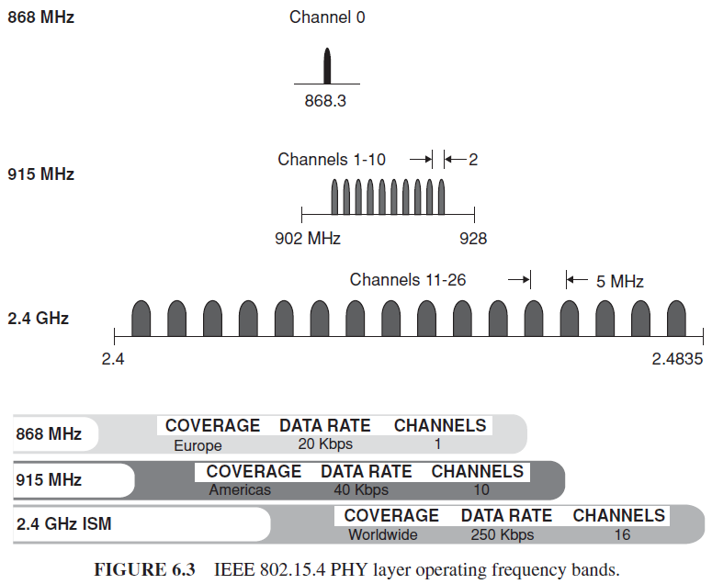
WPAN Technologies for IoT/M2M Zigbee/IEEE 802.15.4

Slide 31
WPAN Technologies for IoT/M2M Zigbee/IEEE 802.15.4
IEEE 802.15.4 defines four types of frames:
beacon frames,
MAC command frames,
acknowledgement frames,
data frames

Slide 32
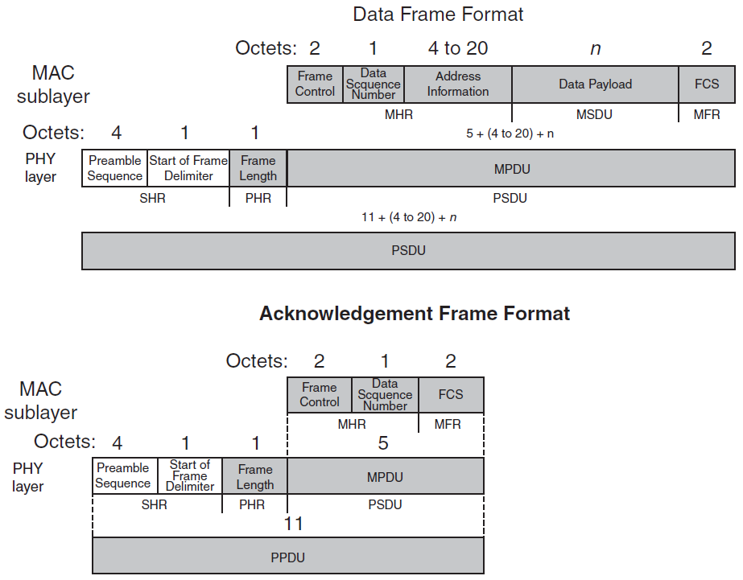
WPAN Technologies for IoT/M2M Zigbee/IEEE 802.15.4

Slide 33
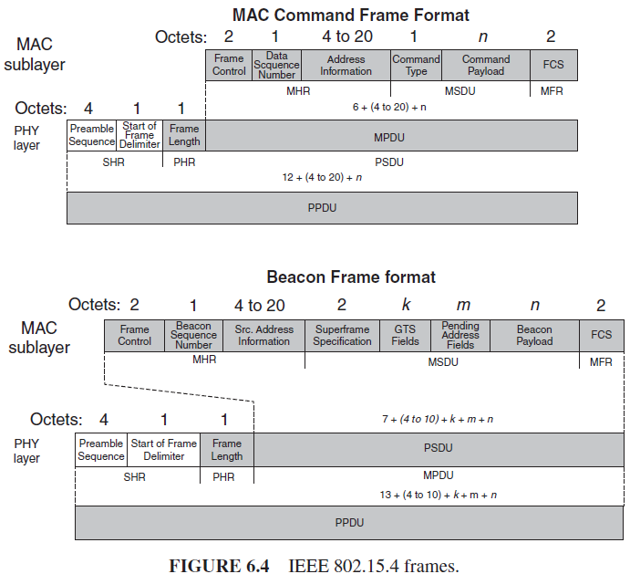
WPAN Technologies for IoT/M2M Zigbee/IEEE 802.15.4

Slide 34
WPAN Technologies for IoT/M2M Zigbee/IEEE 802.15.4
IEEE 802.15.4 networks can either be nonbeacon enabled or beacon enabled.
The latter is an optional mode in which devices are synchronized by a so-called coordinator’s beacons.
This allows the use of super frames within which a contention-free guaranteed time service (GTS) is possible.
In nonbeacon-enabled networks, data frames are sent via the contention-based channel access method of unslotted carrier sense multiple access/collision detect (CSMA/CD).
In nonbeacon-enabled networks, beacons are not used for synchronization; however, they are still useful for link-layer device discovery to aid in association and disassociation events

Slide 35
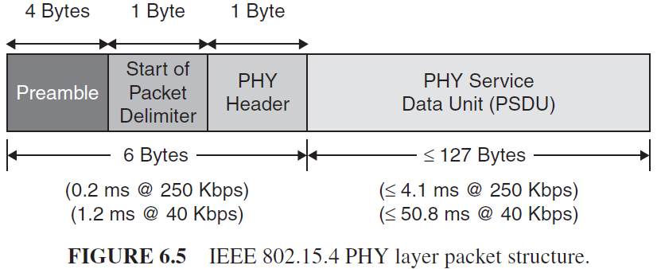
WPAN Technologies for IoT/M2M Zigbee/IEEE 802.15.4
The packet structure of the IEEE 802.15.4 PHY layer shown below.

Slide 36
WPAN Technologies for IoT/M2M Zigbee/IEEE 802.15.4
The first field of this structure contains a 32-bit preamble; this field is used for symbol synchronization.
The next field represents the start of packet delimiter; this field of 8 bits is used for frame synchronization.
The 8-bit PHY header field specifies the length of the PHY service data unit (PSDU).
The PSDU field can carry up to 127 bytes of data.

Slide 37
WPAN Technologies for IoT/M2M Zigbee/IEEE 802.15.4
In order to accommodate the MAC protocol, the IEEE 802.15.4 standard distinguishes devices based on their hardware complexity and capability.
The standard defines two classes of physical devices, namely:
a full function device (FFD)
a reduced function device (RFD).
These device types differ in their use and how much of the standard they implement.
An FFD is equipped with the adequate resources and memory capacity to handle all the functionalities and features specified by the standard.
An RFD is a simple device that carries a reduced set of functionalities, for lower cost and complexity.

Slide 38
WPAN Technologies for IoT/M2M Zigbee/IEEE 802.15.4
Based on these physical device types, ZigBee defines a variety of logical device types. There are three categories of logical devices:
Network coordinator: An FFD device responsible for network establishment and control. The coordinator is responsible for choosing key parameters of the network configuration and for starting the network. It also stores information about the network and acts as the repository for security keys.
Router: An FFD device that supports the data routing functionality, including acting as an intermediate device to link different components of the network and forwarding message between remote devices across multihop paths. A router can communicate with other routers and end devices.
End Devices: An RFD device that contains (just) enough functionality to communicate with its parent node, namely the network coordinator or a router. An end device does not have the capability to relay data messages to other end devices.

Slide 39
WPAN Technologies for IoT/M2M Zigbee/IEEE 802.15.4
A PAN coordinator is the designated principal controller of the WPAN. Every network has exactly one PAN coordinator, selected from within all the coordinators of the network. A coordinator is a network device configured to support network functionalities and additional responsibilities, including:
Managing a list of all associated network devices;
Exchanging data frames with network devices and peer coordinator;
Allocating 16-bit short addresses to network devices. The short addresses, assigned on-demand, are used by the associated devices in lieu of the 64-bit addresses for subsequent communications with the coordinator;
Generating, on a periodic basis, beacon frames. These frames are used to announce the PAN identifier, the list of outstanding frames, and other network and device parameters.

Slide 40
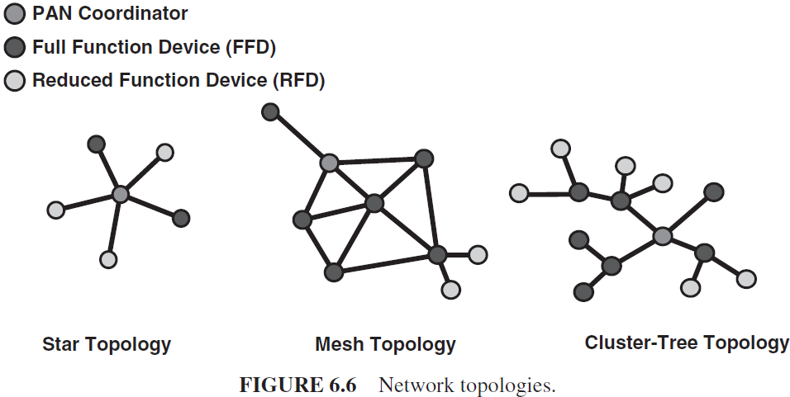
WPAN Technologies for IoT/M2M Zigbee/IEEE 802.15.4
Based on these logical device types, a ZigBee WPAN can be organized into one of three possible topologies, namely a star, a mesh (peer-to-peer), or a cluster tree.

Slide 41
WPAN Technologies for IoT/M2M Zigbee/IEEE 802.15.4
The star network topology supports a single coordinator, with up to 65,536 devices. In this topology configuration, one of the FFD-type devices assumes the role of network coordinator. All other devices act as end devices. The selected coordinator is responsible for initiating and maintaining the end devices on the network. Upon initiation, the end devices can only communicate with the coordinator.
The mesh configuration allows path formation from any source device to any destination device, using tree- and table-driven routing algorithms.
Cluster-tree networks enable a peer–peer network to be formed with a minimum of routing overhead, using multihop routing.

Slide 42
WPAN Technologies for IoT/M2M Zigbee/IEEE 802.15.4
The ZDO (ZigBee device object) represents a predefined base class of functionality upon which all applications are written.
The ZDO creates an abstraction so that the developer can focus on writing application-specific code rather than dealing with the low-level details.
The ZDO provides an interface between the application objects, the profile (e.g., the ZigBee Health Care), and the APS.
The ZDO is responsible for initializing the APS, the network layer, and the security service provider.

Slide 43
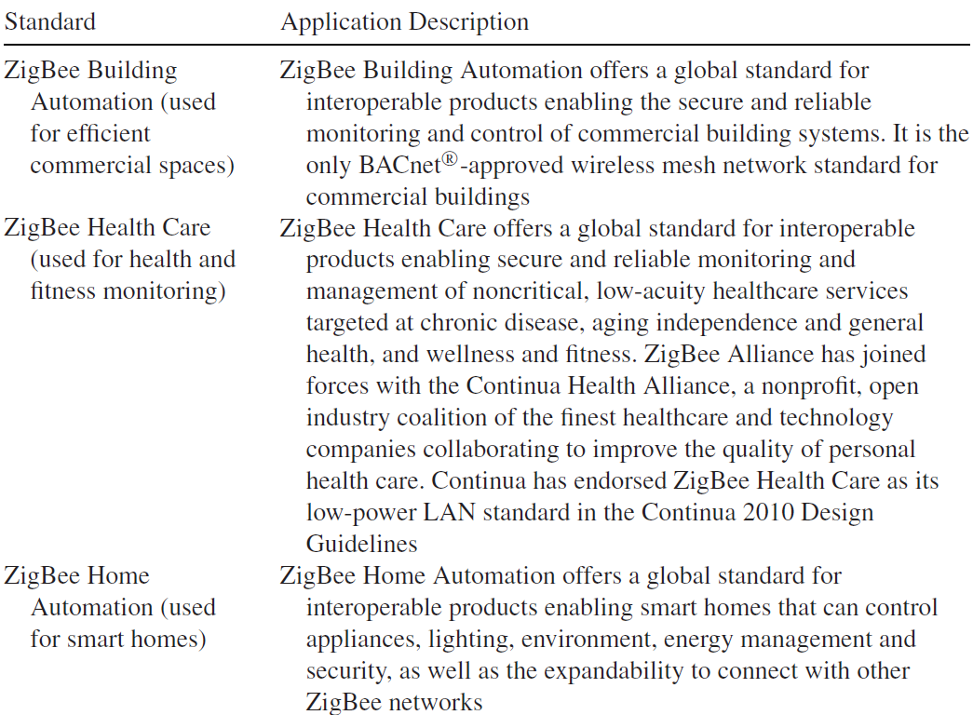
WPAN Technologies for IoT/M2M Zigbee/IEEE 802.15.4
Specific application standards defined and supported by ZigBee and the ZigBee Alliance.

Slide 44
WPAN Technologies for IoT/M2M Zigbee/IEEE 802.15.4
A typical ZIP product implementation would have parameters similar to these:
ZigBee: ZigBee Pro compliant and Full ZigBee Smart Energy (SE) Profile support
Radio: IEEE 802.15.4 compliant ZigBee radio
Operating frequency: 2405–2483.5 MHz, supports ZigBee channels 11 to 26, 5 MHz spacing
Receiver sensitivity: −95 dBm
Transmitter power: +18 dBm output power (<100 mW)
Ethernet and TCP/IP specifications:
Ethernet 10/100 base TX with auto negotiation
Supports standard socket-based communications
Protocols supported: IPv6, UDP, TCP, Telnet, ICMP, ARP, DHCP, BOOTP, Auto IP, HTTP, SMTP, TFTP, HTTPS, SSH, SSL, FTP, PPP, SNMP
Encryption: end-to-end AES 128-bit encryption, 3DES and RC4 encryption for SSH and SSL
Authentication: SHA-1, MD5

Slide 45
WPAN Technologies for IoT/M2M Zigbee/IEEE 802.15.4
ZigBee is designed for low-to-very-low-duty cycle static and dynamic environments with many active nodes;
Bluetooth, is designed for high QoS, variety of duty cycles, and moderate data rates in networks with limited active nodes.

Slide 46
WPAN Technologies for IoT/M2M Radio Frequency for Consumer Electronics (RF4CE)
The specialty-use-driven ZigBee RF4CE protocol has been designed for simple, two-way device-to-device control applications that do not require the full-featured mesh networking capabilities offered by ZigBee.
ZigBee RF4CE offers lower memory size requirements, thereby enabling lower cost implementations.
RF4CE is based on ZigBee and was standardized in 2009 by four consumer electronics (CE) companies: Sony, Philips, Panasonic, and Samsung.

Slide 47
WPAN Technologies for IoT/M2M Radio Frequency for Consumer Electronics (RF4CE)
The characteristics of ZigBee RF4CE include the following:
Operation in the 2.4 GHz frequency band according to IEEE 802.15.4;
Frequency agile solution operating over three channels;
Incorporates power-saving mechanisms for all device classes;
Discovery mechanism with full application confirmation;
Pairing mechanism with full application confirmation;
Multiple star topology with inter-PAN communication;
Various transmission options including broadcast;
Security key generation mechanism;
Utilizes the industry standard AES-128 security scheme;
Specifies a simple RC control profile for CE products;
Support alliance-developed standards or manufacturer-specific profiles.

Slide 48
WPAN Technologies for IoT/M2M Radio Frequency for Consumer Electronics (RF4CE)
RF4CE’s intended use is as a device RC system, for example for television set-top-boxes.
The intention is that it overcomes the common problems associated with infrared (IR): interoperability, line-of-sight (LOS), and limited enhanced features.
Vendors supported RF4CE is: Texas Instruments and Freescale Semiconductor, Inc.

Slide 49
WPAN Technologies for IoT/M2M Bluetooth and its Low-Energy Profile- Overview
Bluetooth is a WPAN technology based on IEEE 802.15.1
Bluetooth was initially developed by Ericsson; in the late 1990s, the Bluetooth Special Interest Group (SIG) made their specifications publicly available.
Soon thereafter, the IEEE 802.15 Group took the Bluetooth work and developed a vendor-independent standard.

Slide 50
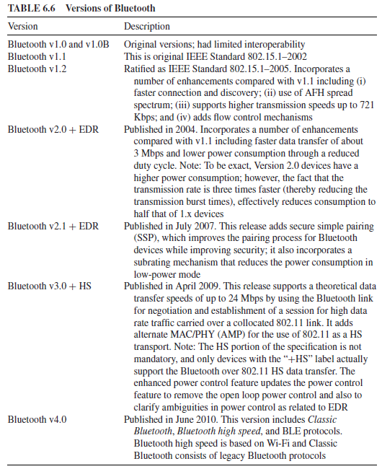
WPAN Technologies for IoT/M2M Bluetooth and its Low-Energy Profile- Overview

Slide 51
WPAN Technologies for IoT/M2M Bluetooth and its Low-Energy Profile- Overview
Bluetooth is a short-range data exchange communication protocol widely used in cellular phones, smartphones, tablets, and PDAs (has a range of about 10 m, or a maximum of 100 m with power boost).
Bluetooth is designed for a small variety of tasks, such as synchronization, voice headsets, cell-modem calls, and mouse and keyboard input.
The Bluetooth specification defines a low-power, low-cost technology that provides a standardized platform for eliminating cables between mobile devices and facilitating connections between products.

Slide 52
WPAN Technologies for IoT/M2M Bluetooth and its Low-Energy Profile- Overview
Bluetooth operates in the 2.4-GHz ISM band and has a bandwidth of approximately 1–3 Mbps.
While the cost of Bluetooth equipment is significantly lower than the cost of WLAN, the transmission range of 10 m or less and the data transfer rate 12 Mbps or less (in Version 2.0 of the standard) are often considered a drawback.

Slide 53
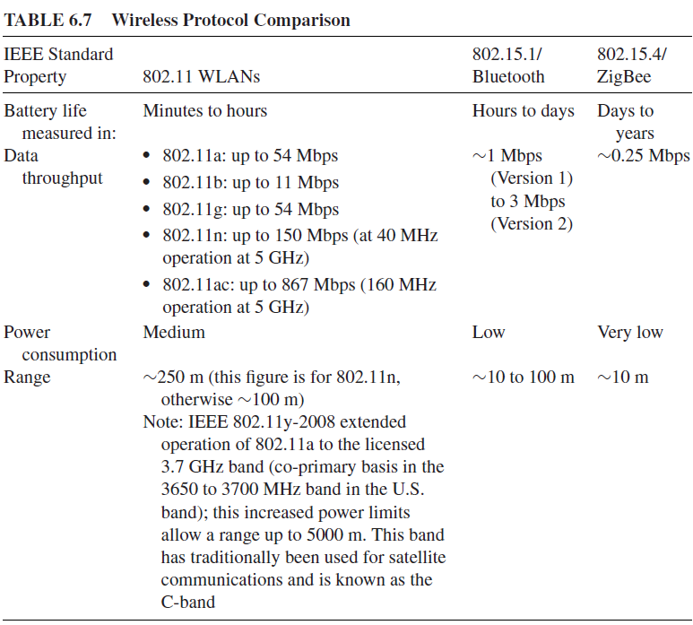
WPAN Technologies for IoT/M2M Bluetooth and its Low-Energy Profile- Overview

Slide 54
WPAN Technologies for IoT/M2M Bluetooth and its Low-Energy Profile- Overview
The sublayers of IEEE 802.15 are as follows:
(i) RF layer;
(ii) baseband layer;
(iii) the link manager (an MAC-level protocol);
(iv) the logical link control and adaptation protocol (L2CAP) (also an MAC-level protocol).

Slide 55
WPAN Technologies for IoT/M2M Bluetooth and its Low-Energy Profile- Overview
RF layer: The air interface is based on antenna power range starting from 0 dBm up to 20 dBm, 2.4 GHz band, and the link range from 0.1 to 10 m.
Baseband layer: The baseband layer establishes the Bluetooth piconet. The piconet is formed when two Bluetooth devices connect. In a piconet, one device acts as the master and the other devices act as slaves.
Link manager: The link manager establishes the link between Bluetooth devices. Additional functions include security, negotiation of Baseband packet sizes, power mode and duty cycle control of the Bluetooth device, and the connection states of a Bluetooth device in a piconet.
L2CAP: This sublayer provides the upper-layer protocols with connectionless and connection-oriented services. The services provided by this layer include protocol multiplexing capability, segmentation and reassembly of packets, and group abstractions.

Slide 56
WPAN Technologies for IoT/M2M Bluetooth and its Low-Energy Profile- Overview
BLE is an alternative to the “power management” features as part of the standard Bluetooth protocols.
BLE is aimed at very low-power applications running off a coin cell:
it is capable of reporting data from a sensor for up to a year from a small button battery without recharging.
data rate and radio range are lower,
the low-power and long battery life make it suitable for short-range monitoring applications in medicine.
BLE sensor devices are typically required to operate for many years without needing a new battery;

Slide 57
WPAN Technologies for IoT/M2M Bluetooth and its Low-Energy Profile- Overview
Current chip designs allow for two types of implementation—
dual mode and single mode.
In a single-mode implementation, the BLE protocol stack is implemented solely.
In a dual-mode implementation, BLE functionality is integrated into an existing Classic Bluetooth controller.
Most new Bluetooth chipsets from leading Bluetooth silicon manufacturers are expected to support Bluetooth and the new BLE functionality

Slide 58
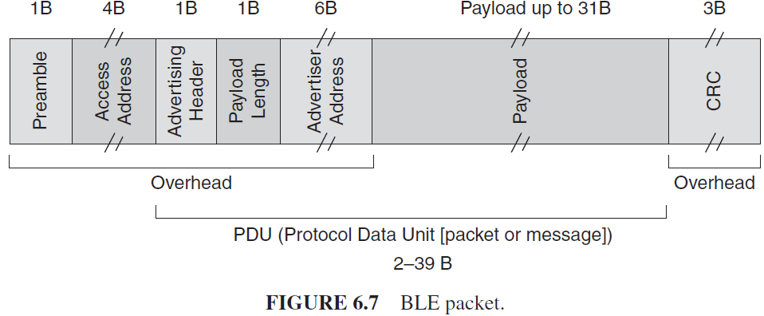
WPAN Technologies for IoT/M2M Bluetooth and its Low-Energy Profile- Overview

Slide 59
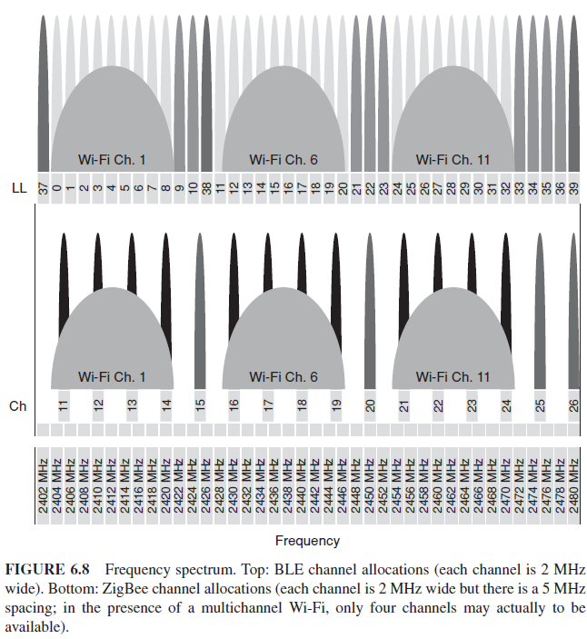
WPAN Technologies for IoT/M2M Bluetooth and its Low-Energy Profile- Overview

Slide 60
WPAN Technologies for IoT/M2M Bluetooth and its Low-Energy Profile- Overview
The IEEE 802.11b and 802.11g specifications postulate a partitioning of the spectrum into 14 overlapping, staggered channels whose center frequencies are 5 MHz apart;
channels 1, 6, and 11 do not overlap.
These channels (or other sets with similar gaps) can be used so that multiple networks can operate in close proximity without interfering with each other.

Slide 61
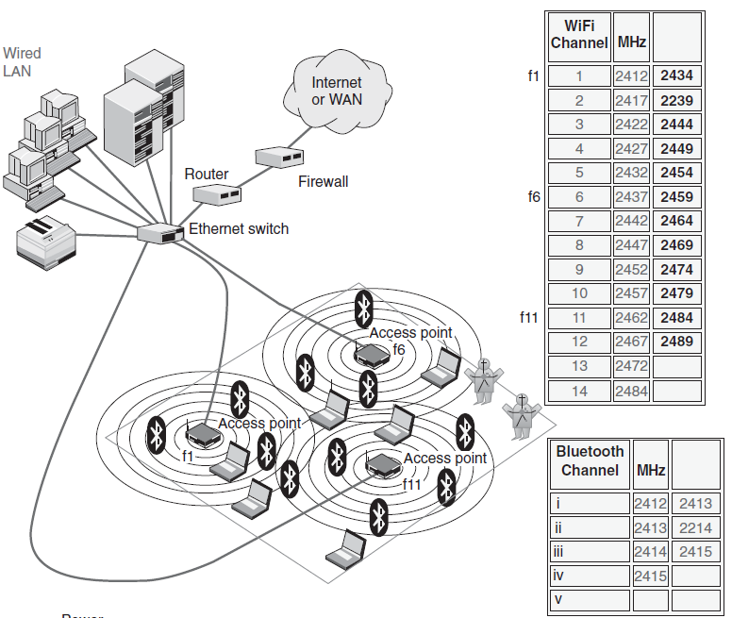
WPAN Technologies for IoT/M2M Bluetooth and its Low-Energy Profile- Overview

Slide 62
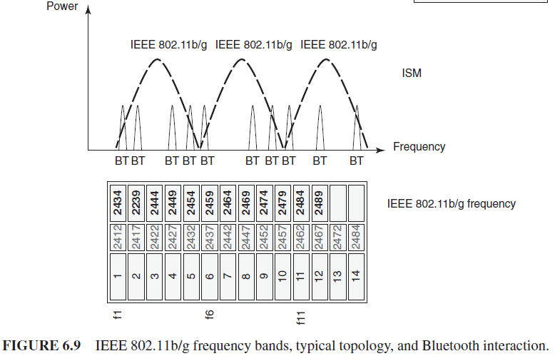
WPAN Technologies for IoT/M2M Bluetooth and its Low-Energy Profile- Overview

Slide 63
WPAN Technologies for IoT/M2M Bluetooth and its Low-Energy Profile- Overview
The spectral mask for 802.11b requires that the signal be at least 30 dB down from its peak energy at ±11 MHz from the center frequency and at least 50 dB down from its peak energy at ±22 MHz from the center frequency.
Note that if the transmitter is sufficiently powerful, the signal can be quite strong even beyond the ±22 MHz point in most situations, however, the signal in a given channel is sufficiently attenuated to minimally interfere with a transmitter on any other channel.

Slide 64
WPAN Technologies for IoT/M2M Bluetooth and its Low-Energy Profile- Overview
Each BLE channel is 2 MHz wide, but the spacing and placement of ZigBee channels implies that only four channels are likely to be free in the presence of average Wi-Fi network settings (typically, channels 1, 6, and 11 are defaults).
With an on-air signaling data rate of only 250 Kbps and the inability to implement hopping, ZigBee is at risk of nondelivery of its packets; BLE, on the other hand, makes much more efficient use of the spectrum and employs adaptive frequency hopping (AFH) as proven by Bluetooth.

Slide 65
WPAN Technologies for IoT/M2M Bluetooth and its Low-Energy Profile- Overview
Bluetooth was used in health care mostly just for interconnection of various medical apparatus called Bluetooth Health Device Profile (HDP).
This profile can be combined with BLE to make sure that medical devices can be in the operational conditions for many months and even years

Slide 66
WPAN Technologies for IoT/M2M Bluetooth and its Low-Energy Profile- Details
The IEEE has reviewed and provided a standard adaptation of the Bluetooth Specification v1.1 Foundation MAC (L2CAP, LMP, and baseband) and PHY (radio) and a clause on service access points (SAPs) that includes an LLC/MAC interface for the ISO/IEC 8802-2 LLC.
A Protocol Implementation Conformance Statement (PICS) proforma has been developed.
Also specified is an informative high-level behavioral ITU-T Z.100 specification and description language (SDL) model for an integrated Bluetooth MAC sublayer.

Slide 67
WPAN Technologies for IoT/M2M Bluetooth and its Low-Energy Profile- Details
Bluetooth radios use a spread spectrum, frequency-hopping, full-duplex signal.
While point-to-point connections are supported, the specification allows up to seven simultaneous connections to be established and maintained by a single radio.
AFH (adaptive frequency hopping) available with newer versions allows for better graceful coexistence with IEEE 802.11 WLAN systems.
The signal hops among 79 frequencies at 1 MHz intervals to give an acceptable degree of interference immunity between multiple Bluetooth devices and between a Bluetooth device and a WLAN device

Slide 68
WPAN Technologies for IoT/M2M Bluetooth and its Low-Energy Profile- Details
Bluetooth version 1.2 allowed a maximum data rate of 1 Mbps; this results in an effective throughput of about 723 Kbps.
Bluetooth Version 2, included EDR (enhanced data rates).
With EDR, the maximum data rate is able to reach 3 Mbps (throughput of 2.1 Mbps) within a range of 10 m (up to 100 m with a power boost).
Older and newer Bluetooth devices can work together with no special effort.

Slide 69
WPAN Technologies for IoT/M2M Bluetooth and its Low-Energy Profile- Details
Bluetooth Core Specification Version 2.0 + EDR include:
Three times faster transmission speed compared with pre-existing technology
Lower power consumption through reduced duty cycle
Simplification of multilink applications due to increased available bandwidth
Backward compatibility to earlier versions
Improved BER (bit error rate) performance

Slide 70
WPAN Technologies for IoT/M2M Bluetooth and its Low-Energy Profile- Details
A Bluetooth device playing the role of “master” can communicate with up to seven devices playing the role of “slave” (these groups of up to eight devices are called piconets).
At any given instant in time, data can be transferred between the master and one slave; but the master switches rapidly from slave to slave in a round-robin fashion. (Simultaneous transmission from the master to multiple slaves is possible, but not used much in practice.)
The Bluetooth specification also allows connecting two or more piconets together to form a scatternet, with some devices acting as a bridge by simultaneously playing the master role in one piconet and the slave role in another piconet.

Slide 71
WPAN Technologies for IoT/M2M Bluetooth and its Low-Energy Profile- Bluetooth HDP
Bluetooth systems for medical application made use of proprietary implementations and data format; typically applications the serial port profile (SPP).
The HDP (Health Device Profile) specification that included the multichannel adaptation protocol (MCAP) and that made use of the device ID (DI) profile.

Slide 72
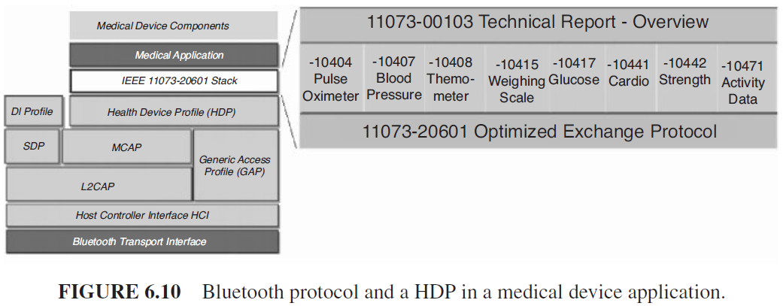
WPAN Technologies for IoT/M2M Bluetooth and its Low-Energy Profile- Bluetooth HDP

Slide 73
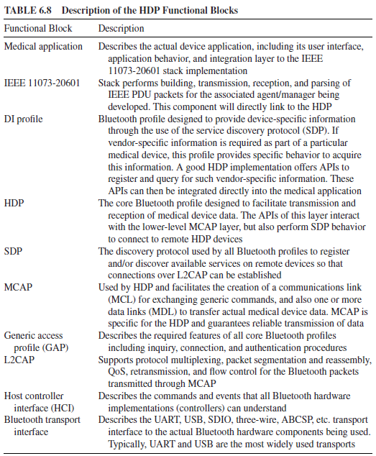
WPAN Technologies for IoT/M2M Bluetooth and its Low-Energy Profile- Bluetooth HDP

Slide 74
WPAN Technologies for IoT/M2M Bluetooth and its Low-Energy Profile- Bluetooth HDP
HDP provides several critical features;
control channel connection/disconnection,
data link creation (reliable or streaming),
data link deletion,
data link abort,
data link reconnection,
data transmission (over one or more data links),
clock synchronization.

Slide 75
WPAN Technologies for IoT/M2M Bluetooth and its Low-Energy Profile- Bluetooth HDP
HDP devices act as sinks and/or sources.
A source is the small device that will act as the transmitter of the medical data (weight scale, glucose meter, thermometer, etc.).
The sink is the feature-rich device that will act as the receiver of the medical data (mobile phone, desktop computer, health appliances, etc.).
HDP devices acting as a source device which transmit application data over a reliable data channel to a sink.
Multiple source devices transmit application data over reliable and streaming data channels to a sink.
This data can then be routed on to a physician through an alternate transport (e.g., the Internet or a mobile phone network) to a medical server application at a hospital.

Slide 76
WPAN Technologies for IoT/M2M Bluetooth and its Low-Energy Profile- Bluetooth HDP
HDP does not define the data format and data content.
The Bluetooth SIG (Special Interest Group) requires for HDP the usage of the IEEE 11073-20601 Personal Health Device Communication Application Profile as the only allowed protocol for data exchange between HDP devices and the IEEE 11073-104xx Device Specification.

Slide 77
WPAN Technologies for IoT/M2M IEEE 802.15.6 WBANs
The technology is intended to support low-power in-body/on-body nodes to serve a variety of medical and nonmedical applications.
The IEEE TG (Task Group) postulated that for a successful implementation of WBAN, a standard model was required, which would be able to address both medical and CE applications.

Slide 78
WPAN Technologies for IoT/M2M IEEE 802.15.6 WBANs
It had received 34 proposals, which were merged into a single candidate proposal.
The standard defines an MAC layer supporting several PHY layers.
The selection of the PHYs (frequency bands) was an important issue.
Medical Implant Communication Service (MICS) band is a licensed band used for implant communication and has the same frequency range (402–405 MHz) in most of the countries.
Wireless Medical Telemetry Services (WMTS) is a licensed band used for medical telemetry system.
Both MICS and WMTS bandwidths do not support high data rate applications.
The ISM band supports high data rate applications and is available worldwide.

Slide 79
WPAN Technologies for IoT/M2M IEEE 802.15.6 WBANs
The current IEEE 802.15.6 standard defines three PHY layers as follows:
the narrowband (NB) layer,
the ultra wideband (UWB) layer,
the human body communications (HBC) layer.
The selection of each PHY depends on the application requirements.
For time-referenced resource allocations, the hub (or the coordinator) divides the time axis (or the channel) into a series of superframes.
The superframes are bounded by beacon periods of equal length.

Slide 80
WPAN Technologies for IoT/M2M IEEE 802.15.6 WBANs
To ensure high-level security, the standard defines three levels:
(a) level 0—unsecured communication,
(b) level 1—authentication only,
(c) level 2—both authentication and encryption

Slide 81
WPAN Technologies for IoT/M2M IEEE 802.15.6 WBANs
The MAC layer in IEEE 802.15.6, the entire channel is divided into superframe structures.
Each superframe is bounded by a beacon period of equal length.
The hub selects the boundaries of the beacon period and thereby selects the allocation slots.
Generally, the beacons are transmitted in each beacon period except in inactive superframes or unless prohibited by regulations such as in MICS band.

Slide 82
WPAN Technologies for IoT/M2M IEEE 802.15.6 WBANs
The access mechanisms used in each period of the superframe are divided into three categories:
(1) random access mechanism, procedure for resource allocation,
(2) improvized and unscheduled access (connectionless contention-free access), which uses unscheduled polling/posting for resource allocation,
(3) scheduled access and variants (connection-oriented contention free access), which schedules the allocation of slots in one or multiple upcoming superframes.
These mechanisms are described in detail in the standard.

Slide 83
WPAN Technologies for IoT/M2M IEEE 802.15 WPAN TG4j MBANs
The purpose of TG4j is to create an amendment to 802.15.4 (Zigbee), which defines a PHY layer for IEEE 802.15.4 in the 2360 to 2400 MHz band and complies with Federal Communications Commission (FCC) MBAN rules.
The title of the TG4j standard under development is:
IEEE Standard for Information Technology—Telecommunications and Information Exchange Between Systems:
Local and Metropolitan Area Network- Specific Requirements.
Wireless Medium Access Control (MAC) and Physical Layer (PHY) Specifications for Low-Rate Wireless Personal Area Networks (WPANs) Amendment:
Alternative Physical Layer Extension to support Medical Body Area Network (MBAN) services operating in the 2360–2400 MHz band.

Slide 84
WPAN Technologies for IoT/M2M IEEE 802.15 WPAN TG4j MBANs
The FCC has issued a Notice of Proposed Rule Making (NPRM) (FCC NPRM 09-57) to allocate the band 2360 to 2400 MHz for MBANSs using body sensor devices.
Service and technical rules allow such devices to operate in this band either on a licensed-by-rule basis under the Medical Device Radiocommunication Service (MedRadio Service) or on a licensed and nonexclusive along with a frequency coordination model to minimize interference to incumbent users in the band.
This project defines an alternate PHY and the necessary modifications to the MAC that are needed to support the PHY operation according to the FCC rules in the MBAN band.

Slide 85
WPAN Technologies for IoT/M2M IEEE 802.15 WPAN TG4j MBANs
IEEE 802.15.6 is addressing communication in the vicinity of, or inside, a human body.
The proposed amendment to IEEE 802.15.4 will address low data rate applications.
IEEE P802.15.6 is targeting significant high data rates and lower power consumption applications.

Slide 86
WPAN Technologies for IoT/M2M ETSI TR 101 557
The 2012 ETSI TR 101 557 Technical Report (TR) has been produced by the ETSI Technical Committee, Electromagnetic Compatibility and Radiospectrum Matters (ERM) to address bandwidth allocations for WBANs/MBANSs.
ETSI has also identified two of the candidate frequency bands proposed for MBANSs (2360–2400 MHz and 2483.5–2500 MHz) as candidate bands for these wireless industrial applications.

Slide 87
WPAN Technologies for IoT/M2M ETSI TR 101 557
MBANSs are used to provide wireless networking of multiple body sensors and actuators used for monitoring patient physiological parameters or healthcare monitoring situations (ambulances and the patient’s home).
The use of MBANSs holds the promise of improved quality and efficiency of patient care by reducing or eliminating a wide array of hardwired, patient-attached cables used by present monitoring technologies.
The ISM radio bands are radio bands allocated internationally for the said purpose. The ISM bands are defined by the ITU-R.
There are a number of ISM bands, but the most well known is the one covering the 2400–2500 MHz region (some other bands include allocations of 6.7 MHz, 13.5 MHz, 26.9 MHz, 40.6 MHz, 433 MHz, 902 MHz, and 5725 MHz).

Slide 88
WPAN Technologies for IoT/M2M ETSI TR 101 557
In ETSI TR 101 557, it is proposed that the bigger portion (75%) of the required operational band should be used only inside the healthcare facilities such as hospitals, clinics, emergency rooms, etc. (indoor use),
The smaller portion (25%) should be used both inside and outside the boundaries of healthcare facilities.
The emission bandwidth used would depend on the data-rate requirement of the particular MBANS application.
For high data-rate applications (e.g., 250 Kbps and beyond), the bandwidth would be 3–5 MHz.
For low data-rate applications, the bandwidth would be 1–3 MHz.

Slide 89
WPAN Technologies for IoT/M2M NFC
Contactless communication allows a user to wave the smartphone over an NFC-compatible device to send information without needing to touch the devices together or go through multiple steps setting up a connection.
NFC is an offshoot of radio frequency identification (RFID), with the exception that NFC is designed for use by devices within close proximity to each other.
NFC utilizes electromagnetic radio fields while technologies such as Bluetooth and Wi-Fi rely on radio transmissions.

Slide 90
WPAN Technologies for IoT/M2M NFC
The technology behind NFC allows a device, known as a reader, interrogator, or active device, to create an electromagnetic field that interacts with another NFC compatible device or a small NFC tag holding the information the reader requires.
Passive devices, such as the NFC tag in smart posters, store information, and communicate with the reader, but these devices do not actively read other devices.
Three forms of NFC technology exist— Type A, Type B, and FeliCa; all three types are similar, but communicate in slightly different ways.
NFC maintains interoperability between different wireless communication methods such as Bluetooth and other NFC standards

Slide 91
WPAN Technologies for IoT/M2M NFC
Standards exist to ensure all forms of NFC technology can interact with other NFC-compatible devices and will work with newer devices in the future.
Two major specifications exist for NFC technology:
ISO/IEC 14443 and ISO/IEC 18000-3.
The ISO/IEC 14443 defines the ID cards used to store information, such as that found in NFC tags. The latter specifies the RFID communication used by NFC devices.
ISO/IEC 18000-3 is an international standard for all devices communicating wirelessly at the 13.56 MHz frequency using Type A or Type B cards, as is the case for NFC.
The devices must be within 4 cm of each other before they can transfer information.
NFC tag is simply referred to as the tag.

Slide 92
WPAN Technologies for IoT/M2M NFC
If the devices are close enough to each other, the tag becomes powered by the interrogator’s signal.
Since the interrogator’s signal powers the tag, the tag can be small in size and can function without any battery or power source of its own.
The two devices create a high frequency magnetic field between the loosely coupled coils in both the interrogating device and the NFC tag.
Once this field is established, a connection is formed and the information can be passed between the interrogator and the tag.
The interrogator sends the first message to the tag to find out what type of communication the tag uses, such as Type A or Type B.
When the tag responds, the interrogator sends its first commands in the appropriate specification.
The tag receives the instruction and checks if it is valid.
If not, nothing occurs.
If it is a valid request, the tag then responds with the requested information.

Slide 93
WPAN Technologies for IoT/M2M NFC
NFC tags function at half duplex; the interrogator functions at full duplex.
Half duplex refers to a device that can only send or receive, but not both at once;
full duplex can do both simultaneously.
An NFC tag can only receive or send a signal, while the interrogating device can receive a signal at the same time it sends a command.

Slide 94
WPAN Technologies for IoT/M2M NFC
Devices using NFC may be active or passive.
A passive device, such as an NFC tag, contains information that other devices can read but does not read any information itself;
Active devices can read information and send it. An active NFC device, such as a smartphone, is not only able to collect information from NFC tags.

Slide 95
WPAN Technologies for IoT/M2M NFC
To ensure security, NFC often establishes a secure channel and uses encryption when sending sensitive information such as credit card numbers.
Users can further protect their private data by keeping antivirus software on their smartphones and adding a password to the phone.

Slide 96
WPAN Technologies for IoT/M2M NFC
As noted, NFC is limited to a distance of approximately 4 cm; Bluetooth does offer a longer signal range for connecting during data communication and transfers.
NFC technology consumes little power when compared to standard Bluetooth technology.
Bluetooth requires users to manually set up connections between smartphones and takes several seconds.
NFC connects automatically in a fraction of a second.

Slide 97
WPAN Technologies for IoT/M2M Dedicated Short-Range Communications (DSRC) and Related Protocols
DSRC is a two-way short-to-medium-range wireless communications capability that permits very high data transmission critical in communications-based active safety applications. E.g. Prevent vehicular crashes.
The FCC allocated 75 MHz of spectrum in the 5.9 GHz band for use by Intelligent Transportation Systems (ITS) vehicle safety and mobility applications.
Vehicle-to-vehicle (V2V) and vehicle-to-infrastructure (V2I) applications utilizing DSRC may have the potential to significantly reduce many of the most deadly types of crashes through real-time advisories alerting drivers to imminent hazards

Slide 98
WPAN Technologies for IoT/M2M Dedicated Short-Range Communications (DSRC) and Related Protocols
DSRC is the only short-range wireless alternative today that provides:
Designated licensed bandwidth: For secure, reliable communications to take place. It is primarily allocated for vehicle safety applications by FCC Report.
Fast network acquisition: Active safety applications require the immediate establishment of communication and frequent updates.
Low latency: Active safety applications must recognize each other and transmit messages to each other in milliseconds without delay.

Slide 99
WPAN Technologies for IoT/M2M Dedicated Short-Range Communications (DSRC) and Related Protocols
High reliability when required: Active safety applications require a high level of link reliability. DSRC works in high vehicle speed mobility conditions and delivers performance immune to extreme weather conditions (e.g., rain, fog, snow, etc.).
Priority for safety applications: Safety applications on DSRC are given priority over non safety applications.
Interoperability: DSRC ensures interoperability, which is the key to successful deployment of active safety applications, using widely accepted standards. It supports both V2V and V2I communications.
Security and privacy: DSRC provides safety message authentication and privacy.

Slide 100
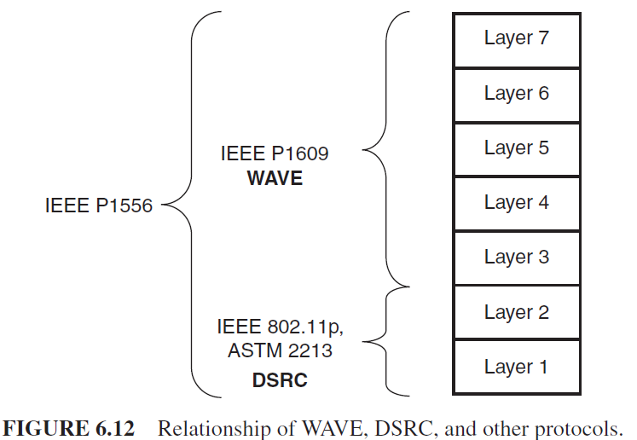
WPAN Technologies for IoT/M2M Dedicated Short-Range Communications (DSRC) and Related Protocols
DSRC devices are IEEE 802.11 systems using the WAVE (wireless access in vehicular environments) mode of operation in the DSRC band.

Slide 101
WPAN Technologies for IoT/M2M Dedicated Short-Range Communications (DSRC) and Related Protocols
IEEE 802.11p is a Standard and defines the MAC layer for wireless communication in vehicular environments.
It supports two different stacks:
IPv6, but only on service channels (not control channel)
WAVE short message protocol (WSMP): can be sent on any channel and allows applications to directly control physical characteristics (channel number and transmitter power)
The IEEE 802.11p standard is positioned as an underlying protocol for car-to-car and car-to-infrastructure applications worldwide.

Slide 102
WPAN Technologies for IoT/M2M Dedicated Short-Range Communications (DSRC) and Related Protocols
WAVE is a mode of operation used by IEEE 802.11 devices to operate in the DSRC band.
WAVE is part of the IEEE 1609 specification, which defines the architecture, the communications model, the management structure, the security, and physical access.
The key architecture components are:
(i) the on-board unit (OBU),
(ii) the road side unit (RSU),
(iii) the WAVE interface.

Slide 103
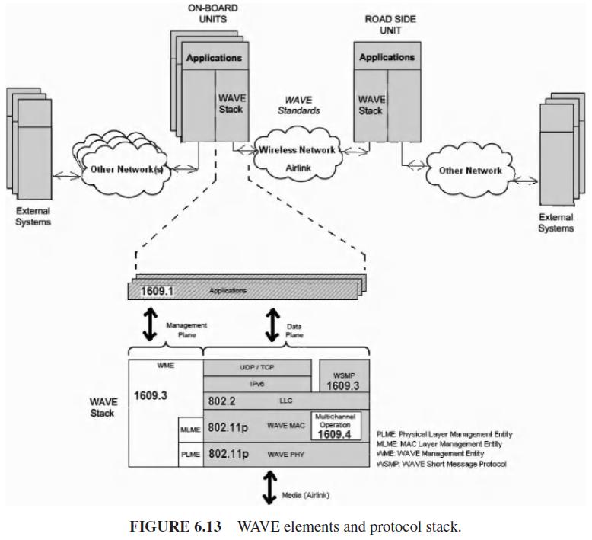
WPAN Technologies for IoT/M2M Dedicated Short-Range Communications (DSRC) and Related Protocols

Slide 104
WPAN Technologies for IoT/M2M Dedicated Short-Range Communications (DSRC) and Related Protocols
Supportive standards are as follows:
P1609.1 Resource Manager describes key components of WAVE system architecture and defines data flows and resources; it also defines command message formats and data storage formats. Finally it also specifies the types of devices that may by supported by OBU;
P1609.2 Security Services for Applications and Management Messages defines secure message formats and processing and describes circumstances for using secure message exchanges;
P1609.3 Networking Services defines network and transport layer services, including addressing and routing, in support of secure WAVE data exchange; it defines WAVE short messages (WSMs), providing an efficient WAVE-specific alternative to IP that can be directly supported by applications. Also it defines the MIB for WAVE protocol stack;
P1609.4 Multichannel Operations defines enhancements to 802.11 MAC to support WAVE.

Slide 105
WPAN Technologies for IoT/M2M Comparison of WPAN Technologies
Some general comparisons between some of the key PAN technologies.
ANT/ANT+ is a mass production technology, establishing itself as the “sports and fitness” space.
ANT endeavors at operating from limited power sources and has built a niche ecosystem.
The same can be said about NIKE+.

Slide 106
WPAN Technologies for IoT/M2M Comparison of WPAN Technologies
BLE is the closest competitor to ANT/ANT+ from an overall raw performance perspective.
BLE used in the mobile handset manufacturers access to a larger product opportunity environment.
BLE provides the best power per bit requirements of the PAN technologies, exceeded only by Wi-Fi.
BLE is likely to turn out to be an important IoT/M2M technology in the healthcare and/or home environment, for example for peripheral and/or smartphone connectivity.

Slide 107
WPAN Technologies for IoT/M2M Comparison of WPAN Technologies
Wi-Fi is normally intended for bulk traffic transfer at high speed (HS).
Wi-Fi requires various drivers and a full protocol stack.
In addition, such systems typically consume significant power at the PC end of the link to minimize latency.

Slide 108
WPAN Technologies for IoT/M2M Comparison of WPAN Technologies
ZigBee and RF4CE are practically the same technology and appear prima facia to require more power compared with the other PAN radio technologies.
These systems are likely to turn out to be important IoT/M2M technologies in the healthcare and/or home environment.

Slide 109
WPAN Technologies for IoT/M2M Comparison of WPAN Technologies
NFC is not seen as a competitor to most low-power wireless technologies; the interest in this technology is that it brings new use cases to the mobile space.
IR transmit-only devices are inexpensive and may still remain a viable option in lowend televisions for the near future, but the technology is also relatively power hungry.
IR is being replaced in many areas by non-LOS radio technology.

Slide 110
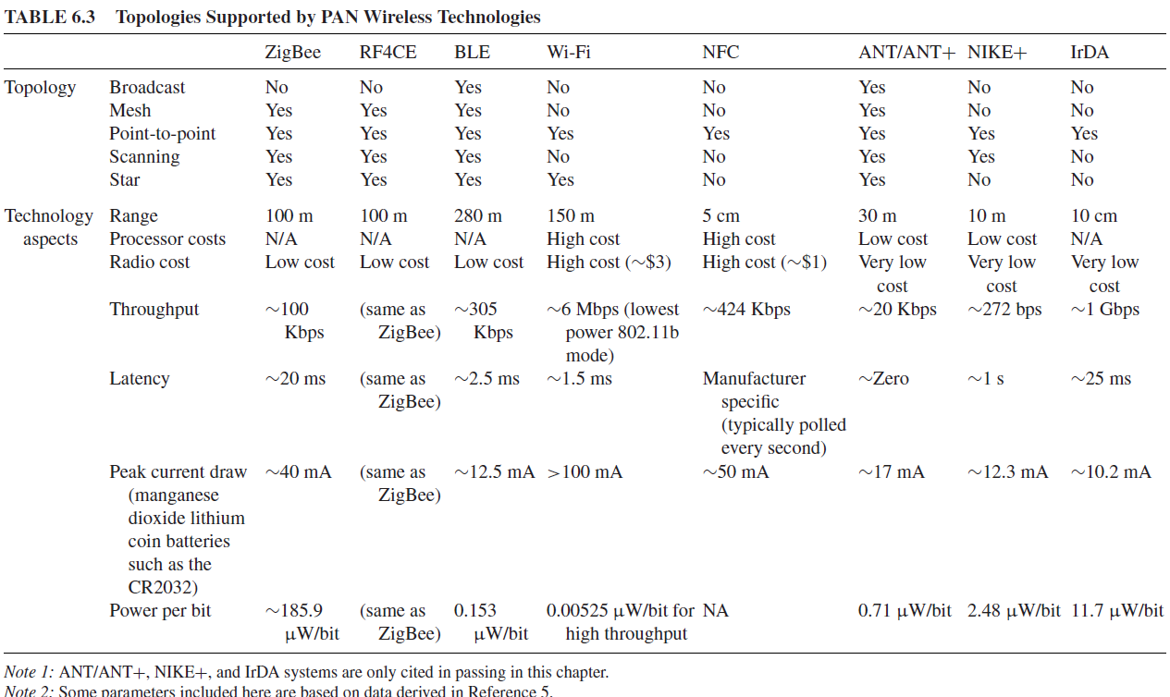
WPAN Technologies for IoT/M2M Comparison of WPAN Technologies

Slide 111
Cellular and Mobile Network Technologies for IoT/M2M
Overview and Motivations
Universal Mobile Telecommunications System
LTE

Slide 112
Cellular and Mobile Network Technologies for IoT/M2M Overview and Motivations
M2M applications are expected to become important sources of traffic and revenues for cellular data networks. For example, energy suppliers routinely utilize SCADA-based systems to enable remote telemetry functions in the power grid.
At this time an increasing number of utilities are turning to public cellular networks to support various functions.

Slide 113
Cellular and Mobile Network Technologies for IoT/M2M Overview and Motivations
Mobile networks, one should keep in mind that IoT/M2M traffic has specific characteristics, which relate to the priority of the data being communicated, the size of the data, the real time streaming needs on one end of the requirements spectrum to the extremely high delay tolerance of the data on the other end of the requirements spectrum, and varying degrees of mobility;
cellular/mobile networks are characterized by varying capacity, bandwidth, link conditions, link utilization, and overall network load, which affect their ability to reliably transfer such M2M data.
These details have to be reconciled in order to be able to cost-effectively utilize cellular technologies for a broad set of applications.

Slide 114
Cellular and Mobile Network Technologies for IoT/M2M Overview and Motivations
Initial 3GPP efforts have focused on the ability to differentiate MTC-type devices, allowing operators to selectively handle such devices in congestion/overload situations.
Cellular technologies are practical and/or ideal for M2M.
Many developers are concentrating on 4G products but, the cost of 4G modules is two times more expensive than 3G modules and three times more expensive than 2G modules;
So network should be cost effective.

Slide 115
Cellular and Mobile Network Technologies for IoT/M2M Universal Mobile Telecommunications System
UMTS is a 3G mobile cellular technology for networks supporting voice and data (IP) based on the GSM standard developed by the 3GPP.
UMTS can carry many traffic types from real-time circuit switched to IP-based packet switched.

Slide 116
Cellular and Mobile Network Technologies for IoT/M2M Universal Mobile Telecommunications System
Universal terrestrial radio access network (UTRAN) is a collective term for the Node BS (base stations) and radio network controllers (RNC) that comprise the UMTS RAN.
NodeB is the equivalent to the base transceiver station (BTS) concept used in GSM.
The UTRAN allows connectivity between the UE and the CN.

Slide 117
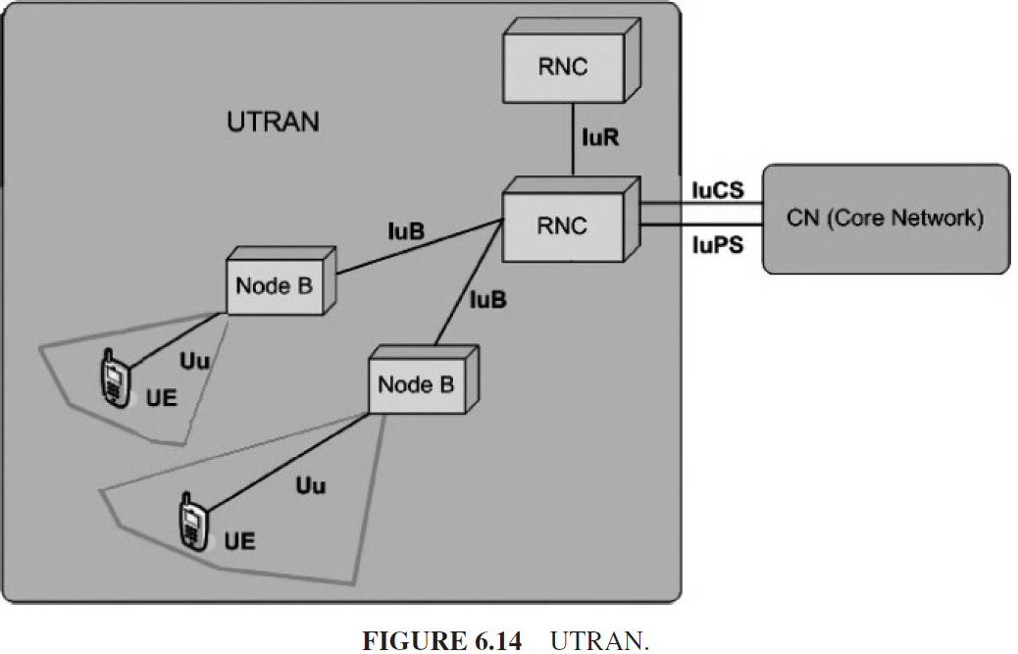
Cellular and Mobile Network Technologies for IoT/M2M Universal Mobile Telecommunications System

Slide 118
Cellular and Mobile Network Technologies for IoT/M2M Universal Mobile Telecommunications System
Video can be supported over the data (IP) capability of a 3G system; mobility is generally supported at the PHY level, but could also be supported with the MIPv6 mechanisms.
The challenge of 3G system is related to bandwidth availability.

Slide 119
Cellular and Mobile Network Technologies for IoT/M2M LTE- Overview
LTE can be viewed as an architecture framework and aims at providing seamless IP connectivity between UE and the packet (IPv4, IPv6) data network without any disruption to the end-users’ applications during mobility.
In contrast to the circuit-switched model of previous-generation cellular systems, LTE has been designed to support only packet-switched services.
LTE is typically used to represent both LTE and SAE (System architecture evolution).

Slide 120
Cellular and Mobile Network Technologies for IoT/M2M LTE- Overview
Together LTE and SAE comprise the EPS (evolved packet system).
EPS provides the user with IP connectivity to a packet data network for accessing the Internet, as well as for supporting services such as streaming video.
The EPS consists of the:
New air interface E-UTRAN (evolved UTRAN) and
The evolved packet core (EPC) network

Slide 121
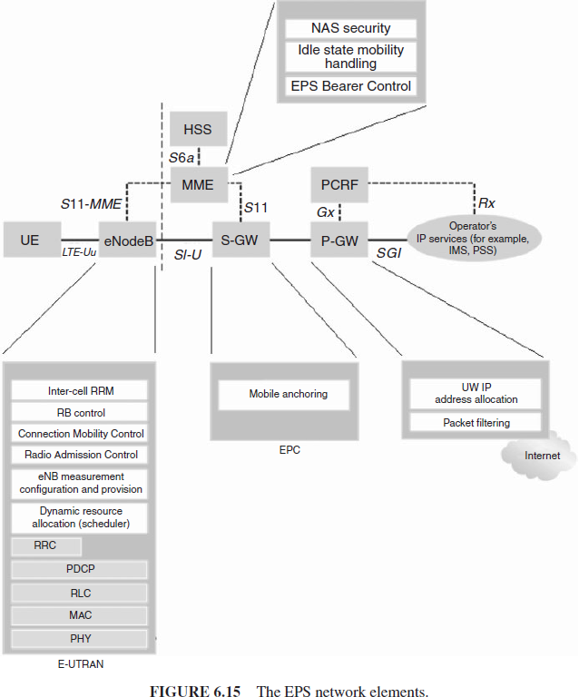
Cellular and Mobile Network Technologies for IoT/M2M LTE- Overview

Slide 122
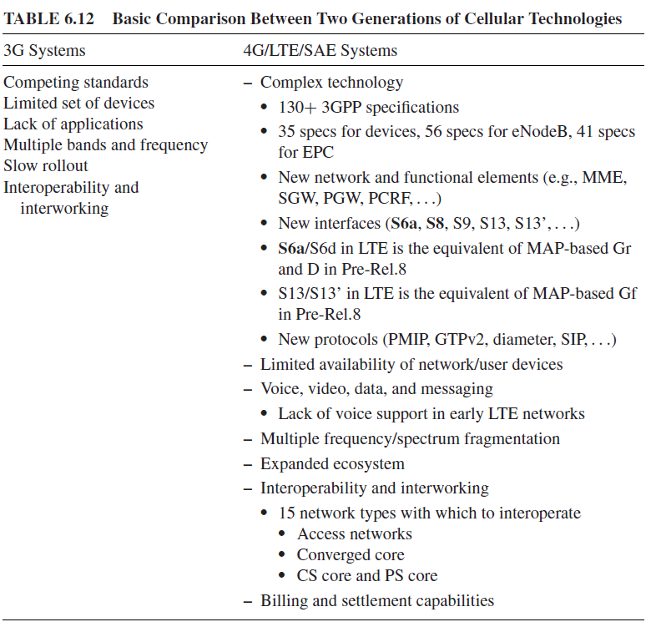
Cellular and Mobile Network Technologies for IoT/M2M LTE- Overview

Slide 123
Cellular and Mobile Network Technologies for IoT/M2M LTE- Overview
LTE promises the following benefits:
Simplified network architecture (Flat IP based);
Efficient interworking;
Robust QoS framework;
Common evolution for multiple technologies;
Real-time, interactive, low-latency true broadband;
Multisession data;
End-to-end enhanced QoS management (see below);
Policy control and management;
High level of security.

Slide 124
Cellular and Mobile Network Technologies for IoT/M2M LTE- Overview
The EPS uses the concept of bearers to route IP traffic from a gateway in the packet data network to the UE.
A bearer is an IP packet flow with a defined QoS between the gateway and the UE. The E-UTRAN and EPC together set up and release bearers as required by applications.
An EPS bearer is often associated with a QoS.
Multiple bearers can be established for an end-user in order to provide different QoS streams or connectivity to different packet data networks or applications reachable via that network.

Slide 125
Cellular and Mobile Network Technologies for IoT/M2M LTE- Overview
For example,
a user might be engaged in watching a video clip while at the same time performing web browsing or FTP download;
a video bearer would provide the necessary QoS for the video stream, while a best-effort bearer would be suitable for the web browsing or file transfer session.
This is achieved by means of several EPS network elements that have different roles.

Slide 126
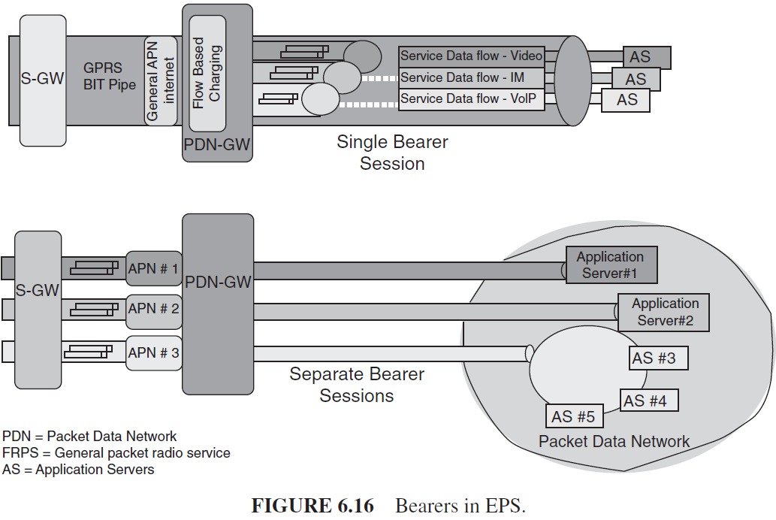
Cellular and Mobile Network Technologies for IoT/M2M LTE- Overview

Slide 127
Cellular and Mobile Network Technologies for IoT/M2M LTE- Core Network
At a high level, the network is comprised of the CN (i.e., the EPC) and the access network E-UTRAN.
While the CN consists of many logical nodes, the access network is comprised of essentially just one node, the evolved NodeB (eNodeB), which connects to the UEs.
Each of these network elements is interconnected over interfaces that are standardized in order to allow multivendor interoperability.

Slide 128
Cellular and Mobile Network Technologies for IoT/M2M LTE- Core Network

Slide 129
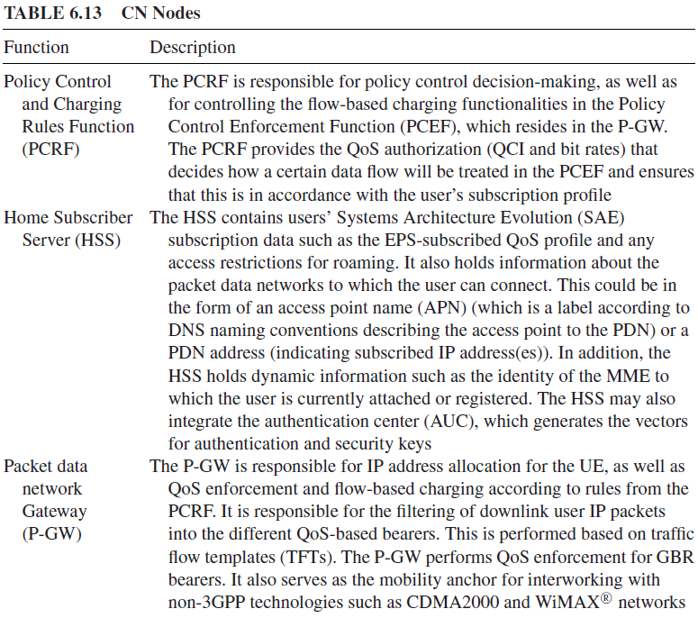
Cellular and Mobile Network Technologies for IoT/M2M LTE- Core Network

Slide 130
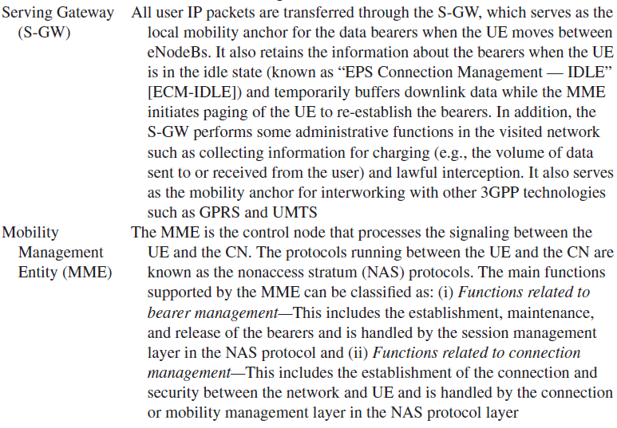
Cellular and Mobile Network Technologies for IoT/M2M LTE- Core Network

Slide 131
Cellular and Mobile Network Technologies for IoT/M2M LTE- Core Network
The CN is responsible for the overall control of the UE and establishment of the bearers.
The main logical nodes of the CN are:
(i) PDN gateway (P-GW);
(ii) serving gateway (S-GW);
(iii) mobility management entity (MME).
In addition to these nodes, the CN also includes other logical nodes and functions such as the Home Subscriber Server (HSS) and the Policy Control and Charging Rules Function (PCRF).
Since the EPS only provides a bearer path of a certain QoS, control of multimedia applications such as packet video is provided by the IP multimedia subsystem (IMS), which is considered to be outside the EPS itself.

Slide 132
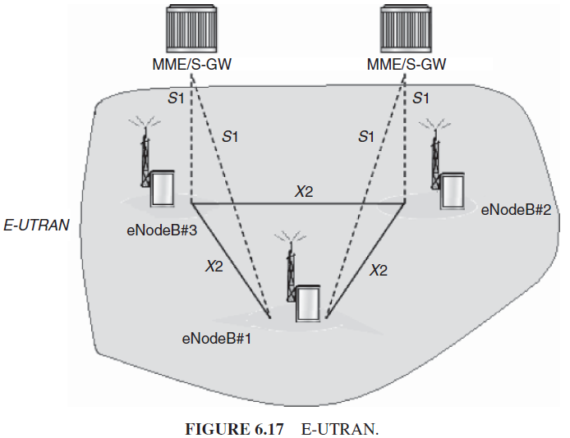
Cellular and Mobile Network Technologies for IoT/M2M LTE- Access Network

Slide 133
Cellular and Mobile Network Technologies for IoT/M2M LTE- Access Network
For normal user traffic (as opposed to broadcast), there is no centralized controller in E-UTRAN; hence the E-UTRAN architecture is said to be flat.
The eNodeBs are normally interconnected with each other by means of an interface known as “X2” and to the EPC by means of the S1 interface—more specifically, to the MME by means of the S1–MME interface and to the S-GW by means of the S1–U interface.
The protocols that run between the eNodeBs and the UE are known as the “AS protocols.”

Slide 134
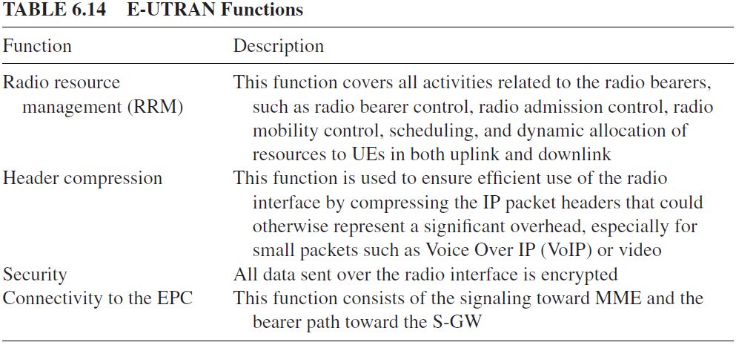
Cellular and Mobile Network Technologies for IoT/M2M LTE- Access Network
For normal user traffic (as opposed to broadcast), there is no centralized controller in E-UTRAN; hence the E-UTRAN architecture is said to be flat.
The eNodeBs are normally interconnected with each other by means of an interface known as “X2” and to the EPC by means of the S1 interface—more specifically, to the MME by means of the S1–MME interface and to the S-GW by means of the S1–U interface.
The protocols that run between the eNodeBs and the UE are known as the “AS protocols.”

Slide 135
Cellular and Mobile Network Technologies for IoT/M2M LTE- Access Network
The eNodeBs, each of which can be responsible for managing multiple cells.
The eNodeB allows tight interaction between the different protocol layers of the RAN, thus reducing latency and improving efficiency.
Such distributed control eliminates the need forma high-availability, processing-intensive controller, which in turn has the potential to reduce costs and avoid “single points of failure.”
Furthermore, as LTE does not support soft handover, there is no need for a centralized data-combining function in the network.
One consequence of the lack of a centralized controller node is that, as the UE moves, the network must transfer all information related to a UE, that is, the UE context, together with any buffered data, from one eNodeB to another; mechanisms are, therefore, needed to avoid data loss during handover.

Slide 136
Cellular and Mobile Network Technologies for IoT/M2M LTE- Roaming
A network run by one operator in a jurisdiction (or service area) is known as a “public land mobile network (PLMN).”
Roaming is the capability where users are allowed to connect to PLMNs other than those to which they are directly subscribed.
A roaming user is connected to the E-UTRAN, MME, and S-GW of the visited LTE network; however, LTE/SAE allows the P-GW of either the visited or the home network to be used.

Slide 137
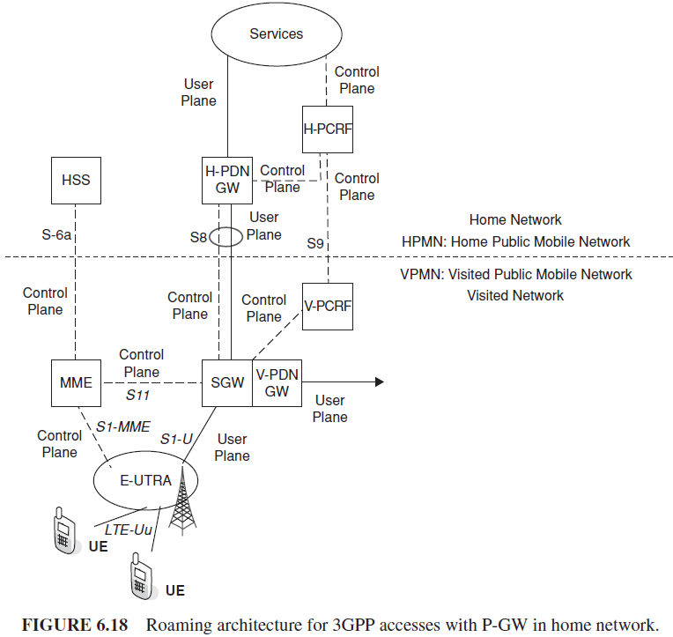
Cellular and Mobile Network Technologies for IoT/M2M LTE- Roaming

Slide 138
Cellular and Mobile Network Technologies for IoT/M2M LTE- Interworking
The EPS also supports interworking and mobility (handover) with networks such as GSM, UMTS, CDMA2000, and WiMAX (worldwide interoperability for microwave access).

Slide 139
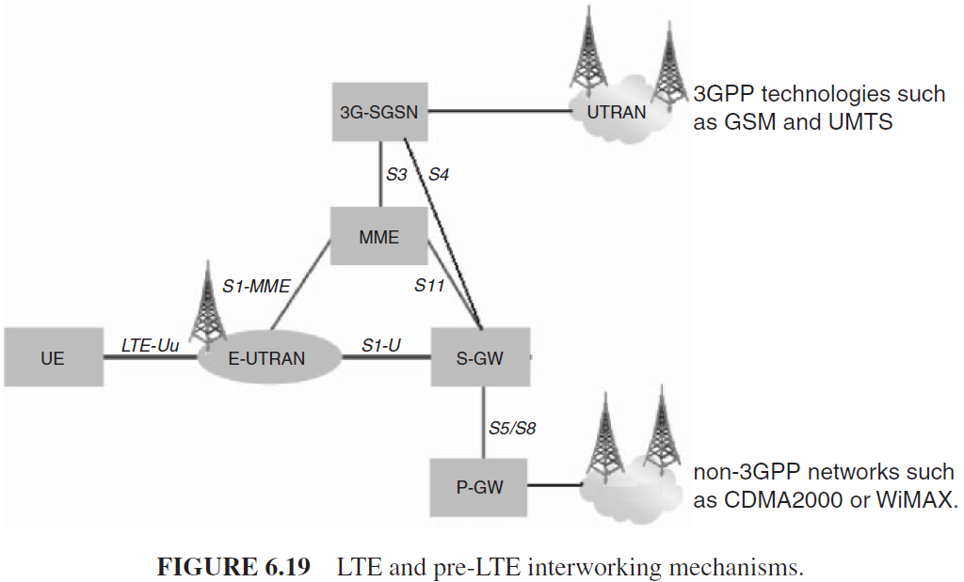
Cellular and Mobile Network Technologies for IoT/M2M LTE- Interworking

Slide 140
Cellular and Mobile Network Technologies for IoT/M2M LTE- Interworking
The S-GW acts as the mobility anchor for interworking with other 3GPP technologies such as GSM and UMTS,
The P-GW serves as an anchor allowing seamless mobility to non-3GPP networks such as CDMA2000 or WiMAX.
The P-GW may also support a Proxy Mobile Internet Protocol (PMIPv6)-based interface.

Slide 141
Cellular and Mobile Network Technologies for IoT/M2M LTE- Protocol Architecture
The protocol architecture spans the user plane and the control plane.

Slide 142
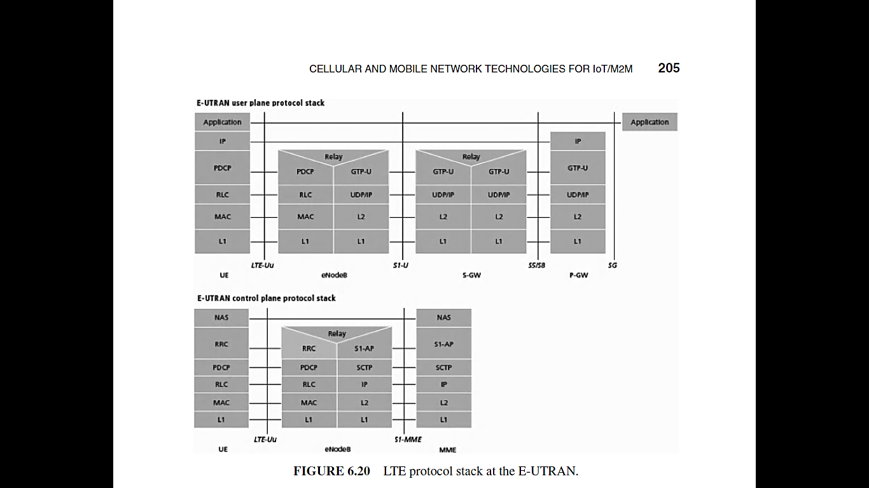
Cellular and Mobile Network Technologies for IoT/M2M LTE- Protocol Architecture

Slide 143
Cellular and Mobile Network Technologies for IoT/M2M LTE- Protocol Architecture
The user plane protocols operate as follows:
An IP packet for a UE is encapsulated in an EPC-specific protocol and tunneled between the P-GW and the eNodeB for transmission to the UE.
Different tunneling protocols are used across different interfaces; A 3GPP-specific tunneling protocol called the GPRS tunneling protocol (GTP) is used over the CN interfaces, S1, and S5/S8.
Consisting of the packet data convergence protocol PDCP), radio link control (RLC) and MAC sublayers that are terminated in the eNodeB on the network side.

Slide 144
Cellular and Mobile Network Technologies for IoT/M2M LTE- Protocol Architecture
The protocol stack for the control plane between the UE and MME is shown in Figure.
The lower layers perform the same functions as for the user plane;
The radio resource control (RRC) protocol is known as “layer 3” in the AS protocol stack and it is the key controlling function in the AS, being responsible for establishing the radio bearers and configuring all the lower layers using RRC signaling between the eNodeB and the UE.

Slide 145
Cellular and Mobile Network Technologies for IoT/M2M LTE- Multiple QoS Management
In order to support multiple QoS requirements, different bearers are set up within the EPS, each being associated with a QoS, being that in a typical environment, multiple applications may be running in a UE at any time, each one having different QoS requirements.
In the access network, it is the responsibility of the eNodeB to ensure the necessary QoS for a bearer over the radio interface.

Slide 146
Cellular and Mobile Network Technologies for IoT/M2M LTE- Multiple QoS Management
Bearers can be classified into two categories:
Minimum guaranteed bit rate (GBR) bearers that can be used for applications such as mobile video.
These bearers have an associated GBR value for which dedicated transmission resources are permanently allocated at bearer establishment or modification (bit rates higher than the GBR may be allowed for a GBR bearer if resources are available).
Non-GBR bearers that do not guarantee any particular bit rate.
These bearers can be used for applications such as, but not limited to, web browsing or FTP transfer. For these bearers, no bandwidth resources are allocated permanently to the bearer.

Slide 147
Cellular and Mobile Network Technologies for IoT/M2M LTE- Multiple QoS Management
Each bearer has an associated QoS class identifier (QCI), and an allocation and retention priority (ARP).
The QCI is a scalar identifying a set of transport characteristics and used to infer node-specific parameters that control packet-forwarding treatment.
Each packet flow is mapped to a QCI value based on the level of service required by the application.
Transport characteristics include bearer with/without GBR, priority, packet loss rate, packet latency budget, and so on.

Slide 148
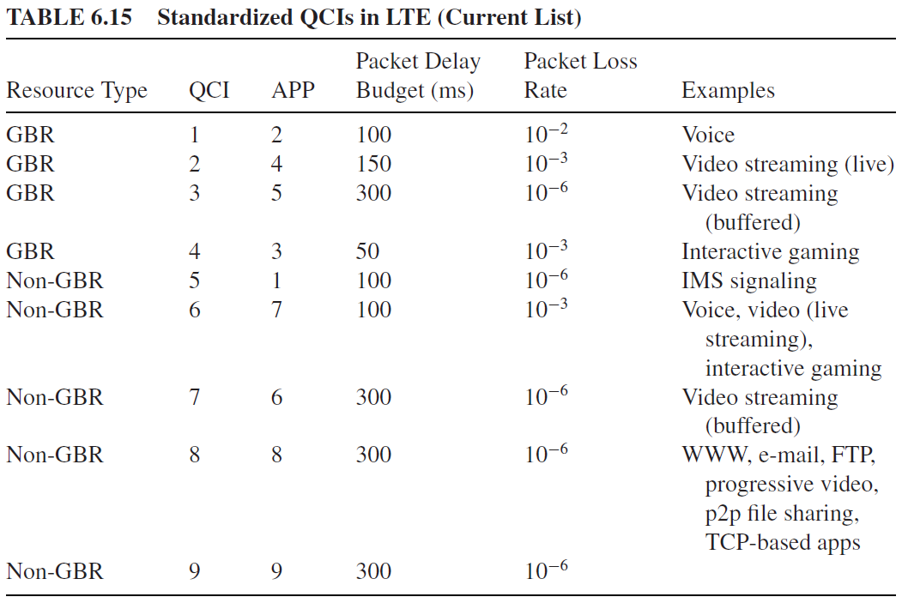
Cellular and Mobile Network Technologies for IoT/M2M LTE- Multiple QoS Management

Slide 149
Cellular and Mobile Network Technologies for IoT/M2M LTE- Signaling
2G/3G networks use SS7-MAP protocol for the following functions:
location
subscriber access
handover
authentication
security/identity management
handover services

Slide 150
Cellular and Mobile Network Technologies for IoT/M2M LTE- Signaling
In LTE/SAE, Diameter Base Protocol (RFC 3588) has been chosen by 3GPP for many of these procedures and is increasingly used for interoperator signaling network and roaming infrastructure.
For example, registration messages received will be based on diameter (rather than SS7-MAP).
The LTE interfaces based on diameter include the following:
Packet core-related interfaces toward HSS and EIR
S6a (MME to HSS) and S6d (SGSN to HSS)
S6b, S6c (external AAA functions for non-3GPP accesses)
S13 (MME to EIR) and S13’ (SGSN to EIR)
Network signaling for policy control and charging
1. S9 (H-PCRF to V-PCRF)
2. S7 (PCRF to P-GW)
3. Gx (PCRF to PCEF)
4. Gxc (PCRF to S-GW)
5. Rx (AF to PCRF)
6. Gy (PCEF to OCS)

Slide 151
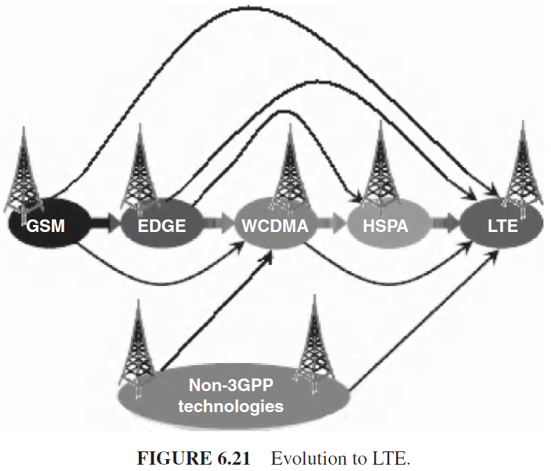
Cellular and Mobile Network Technologies for IoT/M2M LTE- Evolution Paths to 4G/LTE

Slide 152
Cellular and Mobile Network Technologies for IoT/M2M LTE- Evolution Paths to 4G/LTE
Mobile operators are evolving toward LTE/SAE using different evolution paths, as follows
3GPP environments: GSM, GPRS, EDGE, WCDMA, HSPA
Non-3GPP environments: 1xRTT, EV-DO, 3xRTT, WLAN, WiMAX
Network element evolution from 2G/3G to LTE includes the following upgrades in the provider network:
GERAN and UTRAN -> E-UTRAN
SGSN/PDSN-FA ->S-GW
GGSN/PDSN-HA ->PDN-GW
HLR/AAA ->HSS
VLR ->MME
The following signaling evolution from 2G/3G to LTE is needed:
SS7-MAP/ANSI-41/RADIUS ->Diameter
GTPc-v0 and v1 ->GTPc-v2
MIP ->PMIP

Slide 153
Cellular and Mobile Network Technologies for IoT/M2M LTE- Evolution Paths to 4G/LTE
After the LTE environment is established in a portion of the provider’s environment, legacy components of the provider’s network can be supported by the LTE infrastructure

Slide 154
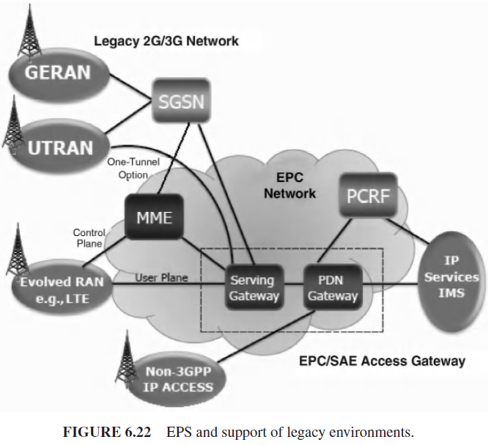
Cellular and Mobile Network Technologies for IoT/M2M LTE- Evolution Paths to 4G/LTE

Slide 155
Layer 3 Connectivity :IPv6 Technologies for the IoT

Slide 156
Overview and Motivations
IPv6 provides improved internetworking capabilities compared to what is presently available with IPv4.
The current IPv4 has been in use for over 30 years, but it exhibits some challenges in supporting emerging demands for address space cardinality, high-density mobility, multimedia, and strong security.
IPv6 offers the potential of achieving scalability, reacheability, end-to-end interworking, quality of service (QoS), and commercial grade robustness that is needed for contemporary and emerging web services, data services, mobile video, and Internet of things (IoT) applications.

Slide 157
Overview and Motivations
IoT may well become the “killerapp” for IPv6.
Using IPv6 with its abundant address spaces, globally unique object (thing) identification and connectivity can be provided in a standardized manner without additional status or address (re)processing; hence, its intrinsic advantage over IPv4 or other schemes.

Slide 158
Overview and Motivations
IP was designed as a packet-based technology (protocol) in the late 1970s–early 1980s for the purpose of connecting computers that were in separate geographic locations.
Starting in the early 1990s, developers realized that the communication needs of the twenty-first century needed a protocol with some new features and capabilities, while at the same time retaining the useful features of the existing protocol.
IPv6 was initially developed in the early 1990s because of the anticipated need for more end-system addresses based on anticipated Internet growth, encompassing mobile phone deployment, smart home appliances, and billions of new users in developing countries (e.g., BRIC: Brazil, Russia, India, China).

Slide 159
Overview and Motivations
IPv6 is now being slowly deployed worldwide.
The U.S. Department of Defense (DoD) announced that from October 1, 2003, all new developments and procurements needed to be IPv6 capable; the DoD’s goal was to complete the transition to IPv6 for all intra- and internetworking across the agency by 2008, which was accomplished.
The current expectation is that IPv4 will continue to exist for the foreseeable future, while IPv6 will be used for new broad-scale applications.
The two protocols are not directly interworkable, but tunneling and dual-stack techniques allow coexistence and co-working.

Slide 160
Overview and Motivations
While the basic function of the network layer internetworking protocol is to move information across networks, IPv6 has more capabilities built into its foundation than IPv4.
Link-level communication does not generally require a node identifier (address) since the device is intrinsically identified with the link-level address; however, communication over a group of links (a network) does require unique node identifiers (addresses).

Slide 161
Overview and Motivations
The IP address is an identifier that is applied to each device connected to an IP network.
In this setup, different entities taking part in the network (servers, routers, user computers, and so on) communicate among each other using their IP address, as an entity identifier.
With IPv4, the 32-bit address can be represented as AdrClass|netID|hostID.
The network portion can contain either a network ID or a network ID and a subnet.
Every network and every host or device has a unique address, by definition.

Slide 162
Overview and Motivations
IPv4 is starting to exhibit limitations, not only with respect to the need for an increase of the IP address space, driven,
for example, by new populations of users in countries such as China and India; by new technologies with “always connected devices” (e.g., cable modems, networked PDAs, 3G/4G mobile smartphones, and so on); and by new services such as global rollout of VoIP, IP Television (IPTV), and social networking.
A regional Internet registry (RIR) manages the allocation and registration of Internet resources such as IPv4 addresses, IPv6 addresses, and autonomous system (AS) numbers, in a specific region of the world.
As of February 1, 2011, only 1% of all possible IPv4 addresses were left unassigned.
This has led to a predicament known as IPv4 Run-Out.

Slide 163
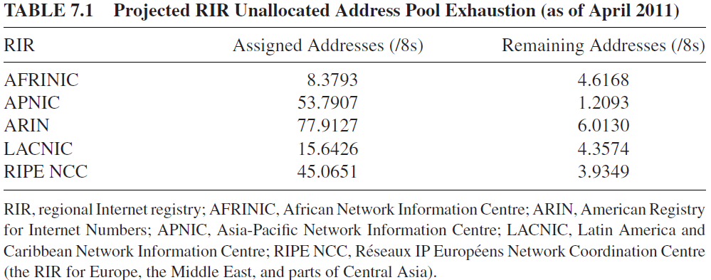
Overview and Motivations

Slide 164
Overview and Motivations
The IPv4 address allocation is based on the following hierarchy:
Internet assigned numbers authority (IANA)→RIRs→internet service providers (ISPs)→the public (including businesses).
Thus, a key desirable capability is the increase in address space such that it is able to cover all elements of the universe set under consideration.
For example, all computing devices could have a public IP address, so that they can be uniquely tracked; this can not achieved with IPv4.
With IPv6, one can use the network to verify that such equipment is deployed in place and active; even non-IT equipment in the field can be tracked by having an IP address permanently assigned to it.
IPv6 creates a newIP address format, such that the number of IP addresses will not exhaust for several decades or longer, even though an entire new crop of devices are expected to connect to Internet over the coming years.

Slide 165
Overview and Motivations
IPv6 has extensive automatic configuration (autoconfiguration) mechanisms and reduces the IT burden, making configuration essentially plug-and-play.
Specifically, new devices that connect to intranet or Internet will be “plug-and-play” devices.
With IPv6, one is not required to configure dynamic non-published local IP addresses, the gateway address, the subnetwork mask, or any other parameters.
The equipment automatically obtains all requisite configuration data when it connects to the network.
Autoconfiguration implies that a dynamic host configuration protocol (DHCP) server is not needed and/or does not have to be configured.

Slide 166
Overview and Motivations
The advantages of IPv6:
Scalability and expanded addressing capabilities:
Plug-and-play:
IPv6 makes it easy for nodes to have multiple IPv6 addresses on the same network interface.
Security
In IPv6, creating a Virtual Private Network (VPN) is easier and more standard than in IPv4
Optimized protocol
Real-time applications
Mobility
Streamlined header format and flow identification
Extensibility

Slide 167
Address Capabilities
IPv4 Addressing and Issues
IPv6 Address Space

Slide 168
Address Capabilities IPv4 Addressing and Issues
IPv4 addresses can be from an officially assigned public range or from an internal intranet private (but not globally unique) block.
As, IPv4 theoretically allows up to 2³² addresses, based on a four-octet address space.
Hence, there are 4,294,967,296 unique values, which can be considered as a sequence of 256 “/8s,” where each “/8” corresponds to 16,777,216 unique address values.
In IPv4, it is a 32-bit (4-byte) binary address used to identify a host’s network ID.
It is represented by the nomenclature a.b.c.d (each of a, b, c, and d being from 1 to 255) (0 has a special meaning).
Examples are 167.168.169.170, 232.233.229.209, and 200.100.200.100.

Slide 169
Address Capabilities IPv4 Addressing and Issues
The problem is that during the 1980s, many public, registered addresses were allocated to firms and organizations without any consistent control.
As a result, some organizations have more addresses that they actually might need, giving rise to the present dearth of available “registerable” layer 3 addresses.
Not all IP addresses can be used due to the fragmentation described above.

Slide 170
Address Capabilities IPv4 Addressing and Issues
The approach to above issue would be a renumbering and a reallocation of the IPv4 addressing space.
However, this is not as simple as it appears since it requires worldwide coordination efforts.
Moreover, it would still be limited for the human population and the quantity of devices that will be connected to Internet in the medium-term future.
As a temporary and pragmatic approach to alleviate the dearth of addresses, network address translation (NAT) mechanisms are employed by organizations and even home users.

Slide 171
Address Capabilities IPv4 Addressing and Issues
Internal devices are assigned IP addresses from a specifically designated range of Class A or Class C address that are locally unique but are duplicatively used and reused within various organizations.
e.g., residential Internet access use via Digital Subscriber Line [DSL] or cable, the legal IP address is only provided to a user on a time-lease basis, rather than permanently.

Slide 172
Address Capabilities IPv4 Addressing and Issues
In the internal intranet private address case, a NAT function is employed to map the internal addresses to an external public address when the private-to-public network boundary is crossed.
This, however, imposes a number of limitations, particularly since the number of registered public addresses available to a company is almost invariably much smaller (as small as 1) than the number of internal devices requiring an address.

Slide 173
Address Capabilities IPv4 Addressing and Issues
A number of protocols cannot travel through a NAT device, and hence the use of NAT implies that many applications (e.g., VoIP) cannot be used effectively in all instances.
As a consequence, these applications can only be used in intranets.
Examples include:
Multimedia applications such as videoconferencing, VoIP, or video-on demand/ IPTV do not work smoothly through NAT devices. Multimedia applications make use of real-time transport protocol (RTP) and real-time control protocol (RTCP). These in turn use User Datagram Protocol (UDP) with dynamic allocation of ports and NAT does not directly support this environment.
IPsec is used extensively for data authentication, integrity, and confidentiality. However, when NAT is used, IPsec operation is impacted, since NAT changes the address in the IP header.
Multicast, although possible in theory, requires complex configuration in a NAT environment and hence, in practice, is not utilized as often as could be the case.

Slide 174
Address Capabilities IPv6 Address Space
The major modifications in the addressing scheme in IPv6 is a change to the basic types of addresses and how they are utilized.
Unicast addresses are utilized for a majority of traditional (enterprise) communications, as was the case in IPv4.
Broadcast as a specific addressing type has been eliminated; in its place support for multicast addressing has been expanded and made a required part of the protocol.
A new type of addressing called anycast has also been implemented.
In addition, there are a number of special IPv6 addresses.

Slide 175
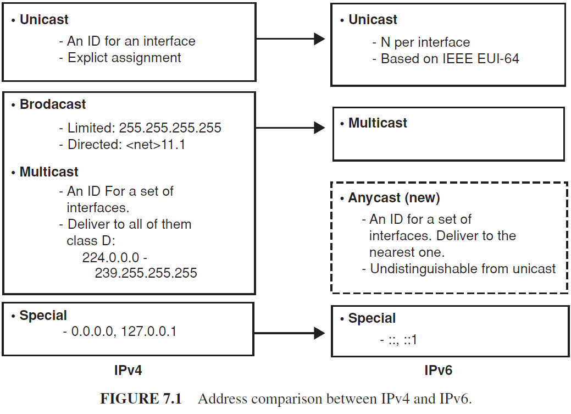
Address Capabilities IPv6 Address Space

Slide 176
Address Capabilities IPv6 Address Space
The types of transmissions as follows:
Unicast transmission: “send to this one specific address”
Multicast transmission: “send to every member of this specific group”
Anycast transmission: “send to any one member of this specific group.”
Typically (motivated by efficiency goals), the transmission occurs to the closest (in routing terms) member of the group. Generally one interprets anycast to mean “send to the closest member of this specific group.”

Slide 177
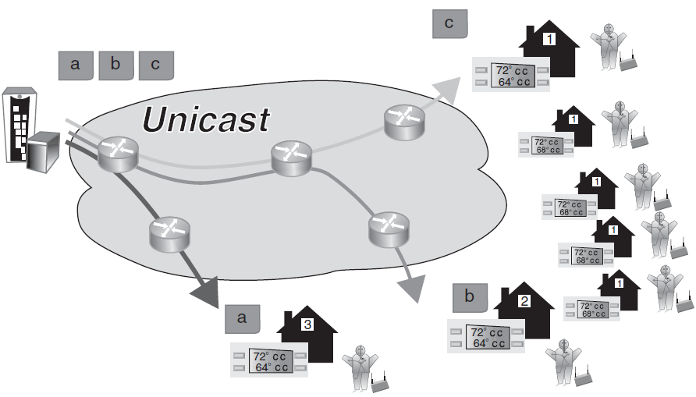
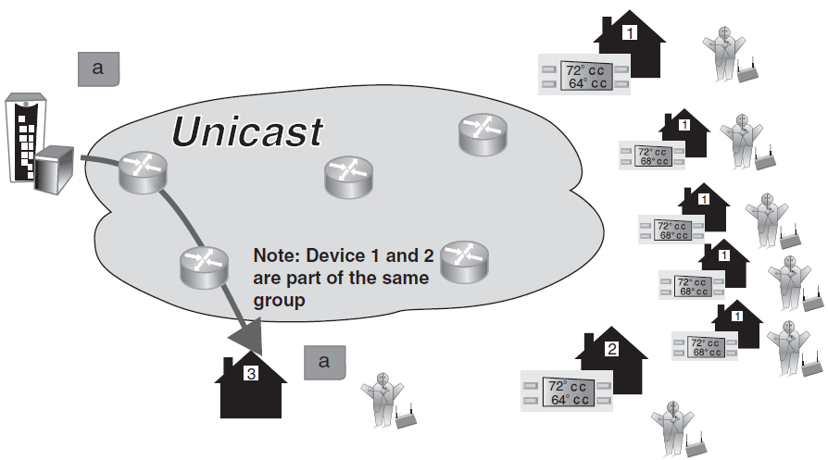
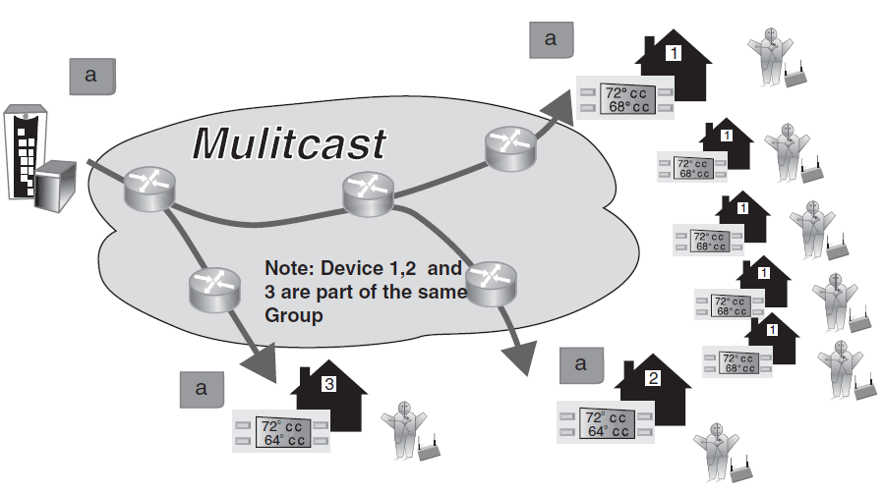
Address Capabilities IPv6 Address Space- Comparison of transmissions to IPv6 nodes

Slide 178
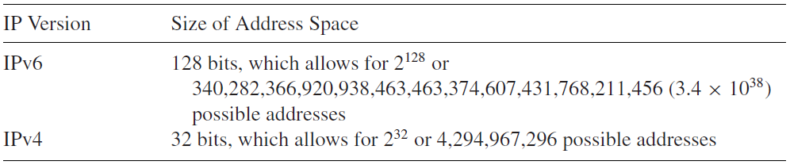
Address Capabilities IPv6 Address Space
The M2M system require support for anycast, unicast, multicast and broadcast communication modes; whenever possible, a global broadcast is expected to be replaced by a multicast or anycast in order to minimize the load on the communication network.
IPv6 address consists of 128 bits, rather than 32 bits as with IPv4 addresses; the number of bits correlates to the address space, as follows:

Slide 179
Address Capabilities IPv6 Address Space
The use of 128 bits provides multiple levels of hierarchy and flexibility in designing hierarchical addressing and routing.
The IPv6 address is represented as eight groups of 16 bits each, separated by the “:”.
Each 16-bit group is represented by 4 hexadecimal digits, that is, each digit has a value between 0 and f (in Hex)
IPv6 address example:
3223:0ba0:01e0:d001:0000:0000:d0f0:0010

Slide 180
Address Capabilities IPv6 Address Space
An abbreviated format exists to designate IPv6 addresses when all endings are 0.
For example
3223:0ba0::
is the abbreviated form of the following address:
3223:0ba0:0000:0000:0000:0000:0000:0000

Slide 181
Address Capabilities IPv6 Address Space
Similarly, only one 0 is written, removing 0’s in the left side, and four 0’s in the middle of the address.
For example the address
3223:ba0:0:0:0:0::1234
is the abbreviated form of the following address
3223:0ba0:0000:0000:0000:0000:0000:1234

Slide 182
Address Capabilities IPv6 Address Space
There is also a method to designate groups of IP addresses or subnetworks that is based on specifying the number of bits that designate the subnetwork, beginning from left to right, using remaining bits to designate single devices inside the network.
For example, the notation
3223:0ba0:01a0::/48
indicates that the part of the IP address used to represent the subnetwork has 48 bits.
Each hexadecimal digit has 4 bits, this points out that the part used to represent the subnetwork is formed by 12 digits, that is: “3223:0ba0:01a0.”
The remaining digits of the IP address would be used to represent nodes inside the network.

Slide 183
Address Capabilities IPv6 Address Space
Datagrams sent to the anycast address are automatically delivered to the device in the network that is the easiest to reach.
Anycast addresses can be used to define a group of devices, any one of which can support a service request from the user sent to a single specific IP address.
E.g.
Situations where one needs a service that can be provided by a set of different (dispersed) servers, but where one does not specifically care which one provides it; a specific example here may be an Internet or video (streaming) cache.

Slide 184
Address Capabilities IPv6 Address Space
E.g.
Anycast addressing is a router arrangement that allows datagrams to be transmitted to whichever router in a group of equivalent routers is closest to the point of transmission;
a specific example here may be to allow load sharing between routers.

Slide 185
Address Capabilities IPv6 Address Space
Special IPv6 addresses, as follows:
Auto-return or loopback virtual address. This address is specified in IPv4 as the 127.0.0.1 address. In IPv6, this address is represented as ::1.
Not specified address (::). This address is not allocated to any node since it is used to indicate absence of address.
IPv6 over IPv4 dynamic/automatic tunnel addresses. These addresses are designated as IPv4-compatible IPv6 addresses and allow the sending of IPv6 traffic over IPv4 networks in a transparent manner. They are represented as, for example, ::156.55.23.5.
IPv4 over IPv6 addresses automatic representation. These addresses allow for IPv4-only nodes to still work in IPv6 networks. They are designated as “mapped from IPv4 to IPv6 addresses” and are represented as ::FFFF:, for example ::FFFF.156.55.43.3.

Slide 186
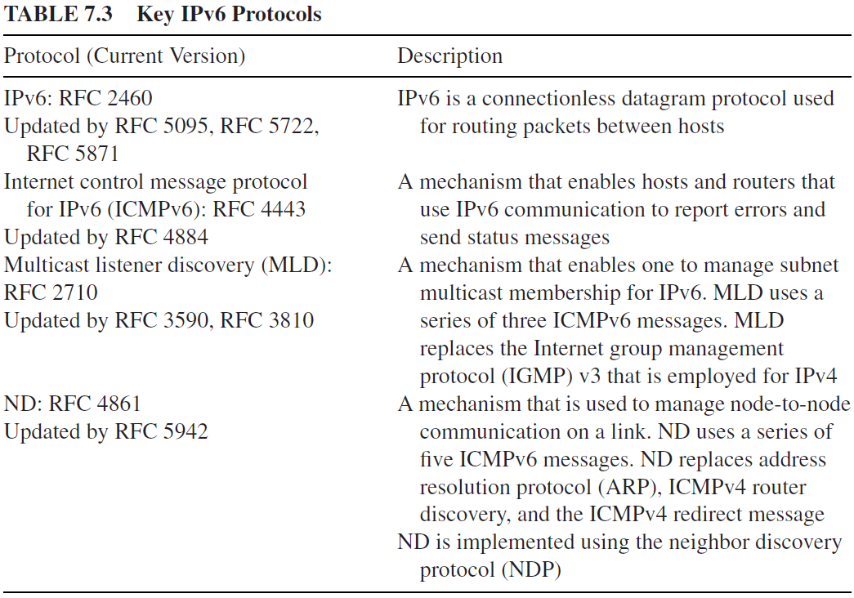
IPv6 Protocol Overview

Slide 187
IPv6 Protocol Overview
IPv6 basic protocol capabilities include the following:
Addressing
Anycast
Flow Labels
ICMPv6
Neighbor discovery (ND)
Like IPv4, IPv6 is a connectionless datagram protocol used primarily for addressing and routing packets between hosts.
Connectionless means that a session is not established before exchanging data.

Slide 188
IPv6 Protocol Overview
“Unreliable” means that delivery is not guaranteed.
IPv6 always makes a best-effort attempt to deliver a packet.
An IPv6 packet might be lost, delivered out of sequence, duplicated, or delayed. IPv6 does not attempt to recover from these types of errors.
The acknowledgment of packets delivered and the recovery of lost packets is done by a higher-layer protocol, such as TCP.
From a packet-forwarding perspective, IPv6 operates in a similar, nearly identical manner to IPv4.

Slide 189
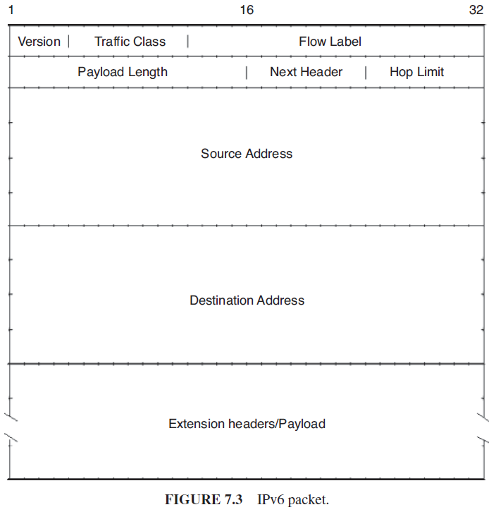
IPv6 Protocol Overview
An IPv6 packet, also known as an IPv6 datagram, consists of an IPv6 header and an IPv6 payload, as shown Figure.

Slide 190
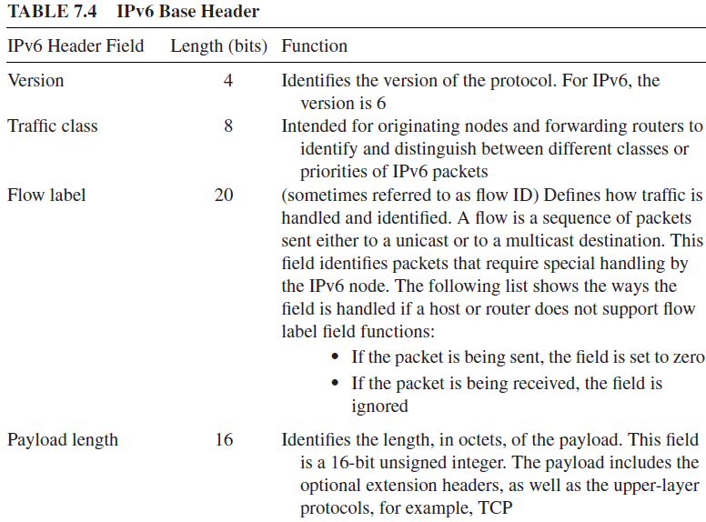
IPv6 Protocol Overview

Slide 191
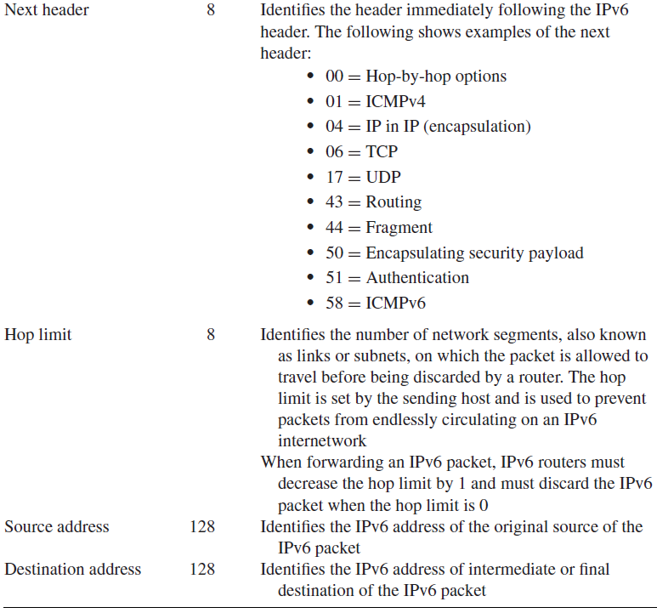
IPv6 Protocol Overview

Slide 192
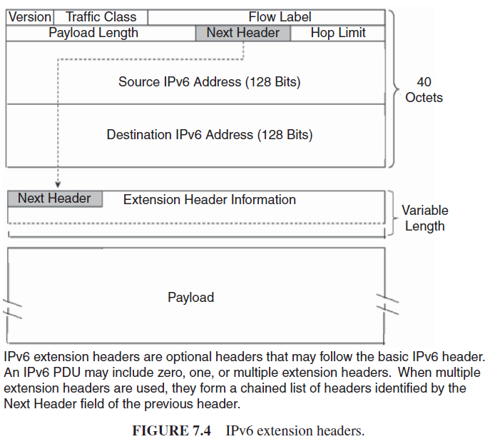
IPv6 Protocol Overview
The IPv6 header consists of two parts, the IPv6 base header and optional extension headers.

Slide 193
IPv6 Protocol Overview
The IPv6 specification defines a number of extension headers :
Routing header—Similar to the source routing options in IPv4. The header is used to mandate a specific routing.
AH—A security header that provides authentication and integrity.
Encapsulating security payload (ESP) header—A security header that provides authentication and encryption.
Fragmentation header—The Fragmentation Header is similar to the fragmentation options in IPv4.
Destination options header—Header that contains a set of options to be processed only by the final destination node. MIPv6 is an example of an environment that uses such a header.
Hop-by-hop options header—A set of options needed by routers to perform certain management or debugging functions.

Slide 194
IPv6 Protocol Overview
Functionally, the optional extension headers and upper-layer protocols, for example TCP, are considered part of the IPv6 payload.

Slide 195
IPv6 Protocol Overview
IPv4 headers and IPv6 headers are not directly interoperable: hosts and/or routers must use an implementation of both IPv4 and IPv6 in order to recognize and process both header formats.

Slide 196
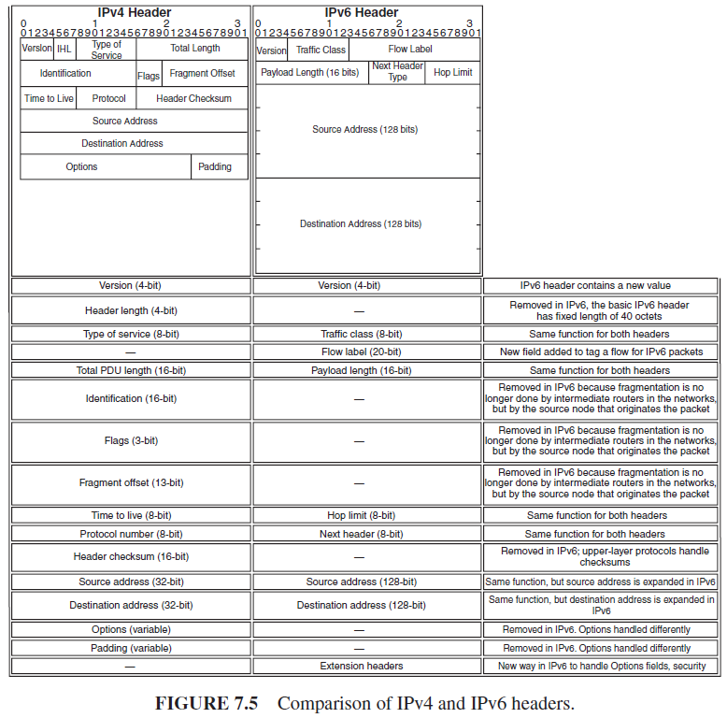
IPv6 Protocol Overview

Slide 197
IPv6 Protocol Overview
This gives rise to a number of complexities in the migration process between the IPv4 and the IPv6 environments.
The IP header in IPv6 has been streamlined and defined to be of a fixed length (40 bytes).
In IPv6, header fields from the IPv4 header have been removed, renamed, or moved to the new optional IPv6 extension headers.
The header length field is no longer needed since the IPv6 header is now a fixed-length entity.

Slide 198
IPv6 Protocol Overview
The IPv4 “type of service” is equivalent to the IPv6 “traffic class” field. The “total length” field has been replaced with the “payload length” field.
Since IPv6 only allows for fragmentation to be performed by the IPv6 source and destination nodes, and not individual routers, the IPv4 segment control fields (identification, flags, and fragment offset fields) have been moved to similar fields within the fragment extension header.
The fragmentation process consists of dividing the source packet into smaller packets or fragments.
The functionality provided by the “time to live (TTL4)” field has been replaced with the “hop limit” field.
The “protocol” field has been replaced with the “next header type” field.
The “header checksum” field was removed, which has the main advantage of not having each relay spend time processing the checksum.
The “options” field is no longer part of the header as it was in IPv4.

Slide 199
IPv6 Protocol Overview
The 40-octet header can be a problem for real-time IP applications such as VoIP and IPTV.
Header compression (HC) becomes critical for many applications.
Also, there will be some bandwidth inefficiency in general, which could be an issue in limited-bandwidth environments or applications (e.g., wireless networks, sensor networks, IoT networks).

Slide 200
IPv6 Protocol Overview
Address autoconfiguration defines how an IPv6 node generates addresses without the use of a DHCP for IPv6 (DHCPv6) server.
“Autoconfiguration” is a new characteristic of the IPv6 protocol that facilitates network management and system set-up tasks by users.
This characteristic is often called “plug-and-play” or “connect-and-work.”
Autoconfiguration facilitates initialization of user devices:
After connecting a device to an IPv6 network, one or several IPv6 globally unique addresses are automatically allocated.
Note, however, that an IPv6 address must be configured on a router’s interface for the interface to forward IPv6 traffic.
Configuring a site-local or global IPv6 address on a router’s interface automatically configures a link-local address (LLA) and activates IPv6 for that interface.

Slide 201
IPv6 Protocol Overview
DHCP allows systems to obtain an IPv4 address and other required information (e.g., default router or domain name system [DNS] server); a similar protocol,DHCPv6, has been published for IPv6.
DHCP and DHCPv6 are known as stateful protocols because they maintain tables on (specialized) servers.
However, IPv6 also has a new stateless autoconfiguration protocol that has no equivalent in IPv4.
The stateless autoconfiguration protocol does not require a server component because there is no state to maintain (a DHCP server may typically run in a router or firewall).
Every IPv6 system (other than routers) is able to build its own unicast global address.
“Stateless” autoconfiguration is also described as “serverless.” Also called SLAAC (stateless address autoconfiguration).
With SLAAC the presence of configuration servers to supply profile information is not required.

Slide 202
IPv6 Protocol Overview
The host generates its own address using a combination of the information that it possesses (in its interface or network card) and the information that is supplied by the router.
Nodes use IPv6 SLAAC to generate addresses using a combination of locally available information and information advertised by routers.
Addresses are formed by combining network prefixes with an interface identifier.
On an interface that contains an embedded IEEE identifier, the interface identifier is typically derived from it and it is generated by random number generation.

Slide 203
IPv6 Protocol Overview
In summary,
All nodes combine interface identifiers (whether derived from an IEEE identifier or generated through some other technique) with the reserved link local prefix to generate LLAs for their attached interfaces.
The “link-local” address is sufficient to allow the communication between several nodes connected to the same link (the same local network).
Additional addresses can then be created by combining prefixes advertised in router advertisements via ND with the interface identifier.
As seen addresses generated using SLAAC contain an embedded interface identifier that remains constant over time.

Slide 204
IPv6 Protocol Overview
IPv6 addresses are “leased” to an interface for a fixed established time (including an infinite time).
When this “lifetime” expires, the link between the interface and the address is invalidated and the address can be reallocated to other interfaces.
For the suitable management of addresses expiration time, an address goes through two states (stages) while is affiliated to an interface:
(a) At first, an address is in a “preferred” state, so its use in any communication is not restricted.
(b) After that, an address becomes “deprecated,” indicating that its affiliation with the current interface will (soon) be invalidated.

Slide 205
IPv6 Protocol Overview
When it is in a “deprecated” state, the use of the address is discouraged, although it is not forbidden.
However, when possible, any new communication (e.g., the opening of a new TCP connection) must use a “preferred” address.
A “deprecated” address should only be used by applications that have already used it before and in cases where it is difficult to change this address to another address without causing a service interruption.

Slide 206
IPv6 Protocol Overview
To ensure that allocated addresses (granted either by manual mechanisms or by autoconfiguration) are unique in a specific link, the link duplicated address detection algorithm is used.
The address to which the duplicated address detection algorithm is being applied to is designated (until the end of this algorithmic session) as an “attempt address.”
In this case, it does not matter that such address has been allocated to an interface and received packets are discarded.

Slide 207
IPv6 Protocol Overview
How an IPv6 address is formed?
The lowest 64 bits of the address identify a specific interface, and these bits are designated as “interface identifier.”
The highest 64 bits of the address identify the “path” or the “prefix” of the network or router in one of the links to which such interface is connected.
The IPv6 address is formed by combining the prefix with the interface identifier.

Slide 208
IPv6 Protocol Overview
To transmit IPv6 traffic over IPv4 networks via tunneling methods.
This approach consists of “wrapping” the IPv6 traffic as IPv4 payload data:
IPv6 traffic is sent “encapsulated” into IPv4 traffic, and at the receiving end this traffic is parsed as IPv6 traffic.
Transition mechanisms are methods used for the coexistence of IPv4 and/or IPv6 devices and networks.
For example, an “IPv6-in-IPv4 tunnel” is a transition mechanism that allows IPv6 devices to communicate through an IPv4 network.
The mechanism consists of creating the IPv6 packets in a normal way and encapsulating them in an IPv4 packet.
The reverse process is undertaken in the destination machine that de-encapsulates the IPv6 packet.

Slide 209
IPv6 Protocol Overview
There is a significant difference between the procedures to allocate IPv4 addresses, which focus on the parsimonious use of addresses (since addresses are a scare resource and should be managed with caution),
The procedures to allocate IPv6 addresses, which focus on flexibility.
RIRs are recommending ISPs (internet service providers) and operators allocate to each IPv6 client a /48 subnetwork; this allows clients to manage their own subnetworks without using NAT.

Slide 210
IPv6 Protocol Overview
In order to allow its maximum scalability, the IPv6 protocol uses an approach based on a basic header, with minimum information.
IPv6 uses a header “concatenation” mechanism to support supplementary capabilities. The advantages of this approach include the following:
The size of the basic header is always the same and is well known. The basic header has been simplified compared with IPv4, since only eight fields are used instead of 12. The basic IPv6 header has a fixed size; hence, its processing by nodes and routers is more straightforward. Also, the header’s structure aligns to 64 bits, so that new and future processors (64 bits minimum) can process it in a more efficient way.
Routers placed between a source point and a destination point (i.e., the route that a specific packet has to pass through) do not need to process or understand any “following headers.” In other words, in general, interior (core) points of the network (routers) only have to process the basic header, while in IPv4 all headers must be processed. This flow mechanism is similar to the operation in MPLS, yet precedes it by several years.
There is no limit to the number of options that the headers can support (the IPv6 basic header is 40 octets in length, while IPv4 one varies from 20 to 60 octets, depending on the options used).

Slide 211
IPv6 Tunneling
IPv6 tunneling is used in a variety of settings, including in MIPv6.
MIPv6 tunnels payload packets between the mobile node (MN) and the home agent (HA) in both directions.
This tunneling uses IPv6 encapsulation.

Slide 212
IPv6 Tunneling
IPv6 tunneling a technique for establishing a “virtual link” between two IPv6 nodes for transmitting data packets as payloads of IPv6 packets.
From the perspective of the two nodes, this “virtual link,” called an IPv6 tunnel, appears as a point-to-point link on which IPv6 acts like a link-layer protocol.
The two IPv6 nodes support specific roles.
One node encapsulates original packets received from other nodes or from itself and forwards the resulting tunnel packets through the tunnel.
The other node decapsulates the received tunnel packets and forwards the resulting original packets toward their destinations.

Slide 213
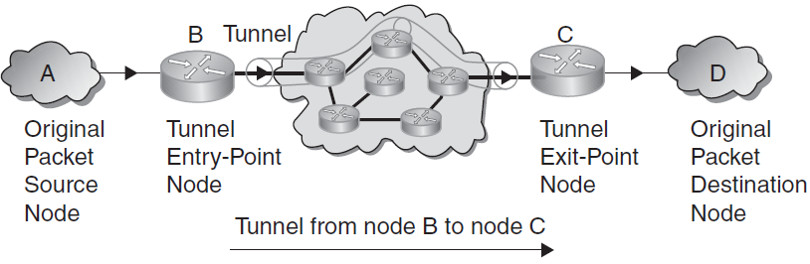
IPv6 Tunneling
The encapsulator node is called the tunnel entry-point node, and it is the source of the tunnel packets.
The decapsulator node is called the tunnel exit point, and it is the destination of the tunnel packets.
An IPv6 tunnel is a unidirectional mechanism— tunnel packet flowtakes place in one direction between the IPv6 tunnel entry-point and exit-point nodes.

Slide 214
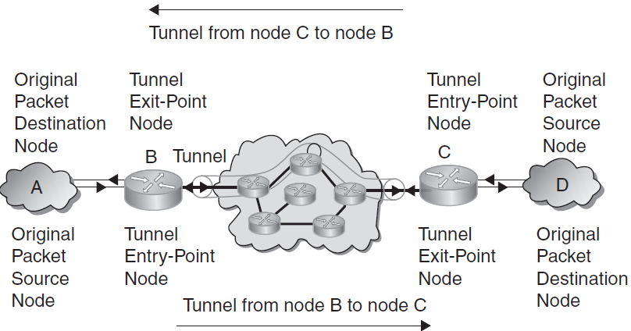
IPv6 Tunneling
Bidirectional tunneling is achieved by merging two unidirectional mechanisms, that is, configuring two tunnels, each in opposite direction to the other—the entry-point node of one tunnel is the exit-point node of the other tunnel.

Slide 215
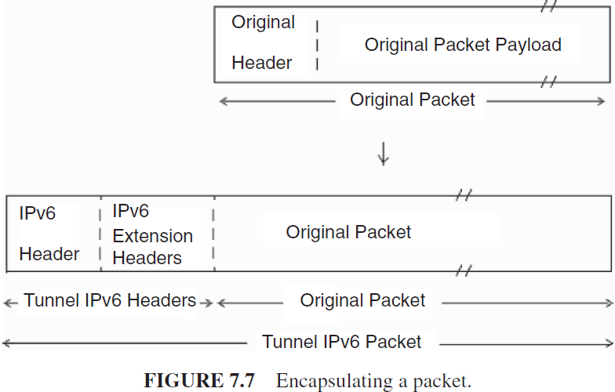
IPv6 Tunneling

Slide 216
IPv6 Tunneling
IPv6 encapsulation
IPv6 intermediate processing
IPv6 decapsulation

Slide 217
IPv6 Tunneling
IPv6 encapsulation
Entails prepending an IPv6 header to the original packet, and, optionally, a set of IPv6 extension headers, that are collectively called tunnel IPv6 headers.
The encapsulation takes place in an IPv6 tunnel entry-point node, as a result of an original packet being forwarded onto the virtual link represented by the tunnel.
The original packet is processed during forwarding according to the forwarding rules of the protocol of that packet.
At encapsulation, the source field of the tunnel IPv6 header is filled with an IPv6 address of the tunnel entry-point node and the destination field with an IPv6 address of the tunnel exit point.
Subsequently, the tunnel packet resulting from encapsulation is sent toward the tunnel exit-point node.

Slide 218
IPv6 Tunneling
IPv6 intermediate
Processing by intermediate nodes in the tunnel processes the IPv6 tunnel packets according to the IPv6 protocol.
For example, a tunnel hop-by-hop options extension header is processed by each receiving node in the tunnel; a tunnel routing extension header identifies the intermediate processing nodes and controls at a finer granularity the forwarding path of the tunnel packet through the tunnel; a tunnel destination options extension header is processed at the tunnel exit-point node.

Slide 219
IPv6 Tunneling
IPv6 decapsulation
Is the opposite process of encapsulation.
Upon receiving an IPv6 packet destined to an IPv6 address of a tunnel exit-point node, its IPv6 protocol layer processes the tunnel headers. The strict left-to-right processing rules for extension headers are applied.
When processing is complete, control is handed to the next protocol engine, which is identified by the next header field value in the last header processed.
If this is set to a tunnel protocol value, the tunnel protocol engine discards the tunnel headers and passes the resulting original packet to the Internet or lower layer protocol identified by that value for further processing.
For example, in the case the next header field has the IPv6 tunnel protocol value, the resulting original packet is passed to the IPv6 protocol layer.
The tunnel exit-point node, which decapsulates the tunnel packets, and the destination node, which receives the resulting original packets, can be the same node.

Slide 220
IPsec (IP Security) in IPv6
IPsec provides network-level security where the application data is encapsulated within the IPv6 packet.
IPsec itself is a set of two protocols:
ESP (Encapsulating security Payload), which provides integrity and confidentiality
AH (Authentication Header), which provides integrity.
IPsec utilizes the AH and/or ESP header to provide security (the AH and ESP header may be used separately or in combination).
IPsec, with ESP, offers integrity and data origin authentication, confidentiality, and optional (at the discretion of the receiver) antireplay features (using confidentiality without integrity is discouraged by the RFCs); in addition, ESP provides limited traffic flow confidentiality.

Slide 221
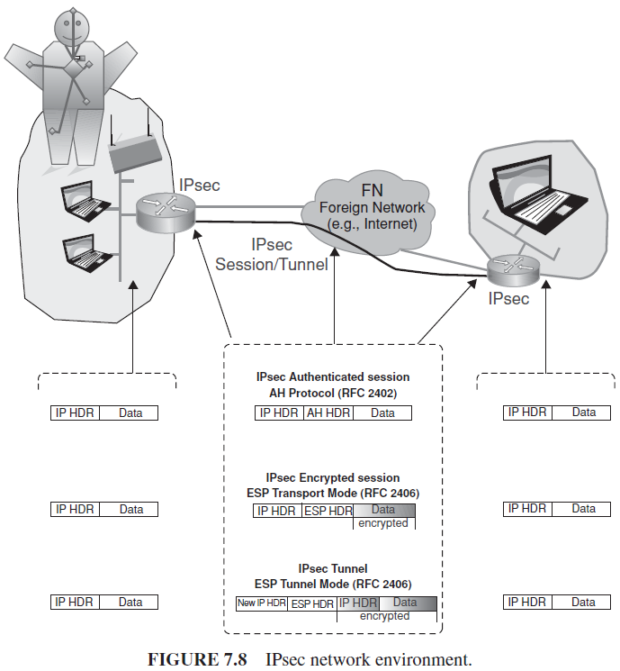
IPsec (IP Security) in IPv6

Slide 222
IPsec (IP Security) in IPv6
Both the AH and ESP header may be employed as follows:
“Tunnel mode”—The protocol is applied to the entire IP packet. This method is needed to ensure security over the entire packet, where a new IPv6 header and an AH or ESP header are wrapped around the original IP packet.
“Transport mode”—The protocol is just applied to the transport layer (i.e., TCP, UDP, ICMP) in the form of an IPv6 header and AH or ESP header, followed by the transport protocol data (header, data).

Slide 223
Header Compression Schemes
Header compression (HC)
Implementation of IPv6 gives rise to concerns related to expanded packet headers, especially for video and wireless (low bandwidth channel) applications.
The packet header size doubled from 20 bytes in IPv4 to at least 40 bytes in IPv6.
The use of network-layer encryption mechanism nearly doubles IP operational overhead.
The use of HC in commercial networks is generally rare, but wireless and video applications (especially in an IPv6 environment) may well drive future deployment of the technology.

Slide 224
Header Compression Schemes
HC algorithms can reduce the performance and throughput impact of expanded IPv6 packet headers and protocol-imposed overhead.
Overhead is defined as “IP header bytes” divided by “total bytes transmitted.”
Naturally, the overhead for larger packets will be less as a total percentage.

Slide 225

Header Compression Schemes
Compression is applied to layer 3 (IP) and several layer 4 protocol headers; for example, RTP/UDP/IPv6 headers can be compressed from 60 bytes to 2–4 bytes.

Slide 226
Header Compression Schemes
HC algorithms can also reduce the additional overhead introduced by network-layer encryption mechanisms (e.g., IPsec).
Compression algorithms that address encryption/decryption have the ability to:
(i) compress inner headers before encryption
(ii) compress outer ESP/IP headers after encryption.

Slide 227
Header Compression Schemes
Two compression protocols:
(i) Internet protocol header compression (IPHC), a scheme designed for low bit error rate (BER) links; it provides compression of TCP/IP, UDP/IP, RTP/UDP/IP, and ESP/IP header; “enhanced” compression of RTP/UDP/IP (ECRTP) headers is defined in RFC 3545.
(ii) Robust header compression (ROHC) is a scheme designed for wireless links that provides greater compression compared to IPHC at the cost of greater implementation complexity; this is more suitable for high BER, long RTT links and supports compression of ESP/IP, UDP/IP, and RTP/UDP/IP headers.

Slide 228
Header Compression Schemes
Compression is applied over a link between a source node (i.e., compressor) and a destination node (i.e., decompressor).
HC algorithms make use of protocol inter packet header field redundancies to improve overall efficiency. Both compressor and decompressor store header fields of each packet stream and associate each stream with a context identifier (CID).
Upon reception of a packet with an associated context, the compressor removes the IPv6 header fields from packet header and appends a CID.
Upon reception of a packet with a CID, the decompressor inserts IPv6 header fields back into packet header and transmits packet.

Slide 229
Header Compression Schemes
Point-to-point protocol (PPP) (defined in RFC 1661) provides
(i) a method for encapsulating datagrams over serial links;
(ii) a link control protocol (LCP) for establishing, configuring, and testing the data-link connection;
(iii) a family of network control protocols (NCPs) for establishing and configuring different network layer protocols.
In order to establish communications over a point-to-point link, each end of the PPP link must first send LCP packets to configure and test the data link.
After the link has been established and optional facilities have been negotiated as needed by the LCP, PPP must send NCP packets to choose and configure one or more network-layer protocols.

Slide 230
Quality of Service in IPv6
QoS is supported in IPv6. The IPv6 header has two QoS-related fields:
20-bit flow label, usable in IntServ-based environments. In IntServ environments, performance guarantees to traffic and resource reservations are provided on per-flow basis. A guaranteed and controlled load service capability is supported. IntServ approaches have scalability issues;
8-bit traffic class indicator usable in DiffServ-based environments. DiffServ environments are more common. The traffic class field may be used to set specific precedence or differentiated services code point (DSCP) values. These values are used in the exact same way as in IPv4. Performance guarantees are provided to traffic aggregates rather than to flows. DiffServ classifies all the network traffic into classes. Two distinct types (per hop behaviors) are supported:
Expedited forwarding (EF): aims at providing QoS for the class by minimizing jitter and is generally focused on providing stricter guarantees;
Assured forwarding (AF): inserts at most four classes with at most three levels of packets dropping categories.

Slide 231
Quality of Service in IPv6
There are no signaling protocol for resource allocation (admission control) and QoS mechanisms control.
The following priority levels are typical, but variances are possible:
Level 0—No specify priority
Level 1—Background traffic (news)
Level 2—Unattended data transfer (email)
Level 3—Reserved
Level 4—Attended bulk transfer (FTP)
Level 5—Reserved
Level 6—Interactive traffic (Telnet, Windowing)
Level 7—Control traffic (routing, network management)

Slide 232
Migration Strategies to IPv6
Technical Approaches
Residential Broadband Services in an IPv6 Environment
Deployment Opportunities

Slide 233
Migration Strategies to IPv6 Technical Approaches
Migration from IPv4 to IPv6 environments is expected to be fairly complex.
However, with the growth in the number of users and the IPv4 address exhaustion, large-scale deployment will invariably happen in the near future.
Fortunately, the new protocol supports an IPv4-compatible IPv6 address that is an IPv6 address employing embedded IPv4 addresses i.e. Tunneling,

Slide 234
Migration Strategies to IPv6 Technical Approaches
There are a number of requirements that are typically applicable to an organization wishing to introduce an IPv6 service :
The existing IPv4 service should not be adversely disrupted (e.g., as it might be by router loading of encapsulating IPv6 in IPv4 for tunnels);
The IPv6 service should perform as well as the IPv4 service (e.g., at the IPv4 line rate, and with similar network characteristics);
The service must be manageable and be able to be monitored (thus tools should be available for IPv6 as they are for IPv4);
The security of the network should not be compromised, due to the additional protocol itself or a weakness of any transition mechanism used; and
An IPv6 address allocation plan must be drawn up.

Slide 235
Migration Strategies to IPv6 Technical Approaches
Interworking mechanisms include the following:
Dual IP layer (also known as dual stack): A technique for providing complete support for both IPs—IPv4 and IPv6—in hosts and routers;
Configured tunneling of IPv6 over IPv4: Point-to-point tunnels made by encapsulating IPv6 packets within IPv4 headers to carry them over IPv4 routing infrastructures; and
Automatic tunneling of IPv6 over IPv4:Amechanism for using IPv4-compatible addresses to automatically tunnel IPv6 packets over IPv4 networks.

Slide 236
Migration Strategies to IPv6 Technical Approaches
Tunneling techniques include the following approaches:
IPv6-over-IPv4 tunneling: The technique of encapsulating IPv6 packets within IPv4 so that they can be carried across IPv4 routing infrastructures.
Configured tunneling: IPv6-over-IPv4 tunneling where the IPv4 tunnel endpoint address is determined by configuration information on the encapsulating node. The tunnels can be either unidirectional or bidirectional. Bidirectional configured tunnels behave as virtual point-to-point links.
Automatic tunneling: IPv6-over-IPv4 tunneling where the IPv4 tunnel endpoint address is determined from the IPv4 address embedded in the IPv4-compatible destination address of the IPv6 packet being tunneled.
IPv4 multicast tunneling: IPv6-over-IPv4 tunneling where the IPv4 tunnel endpoint address is determined using ND. Unlike configured tunneling, this does not require any address configuration, and unlike automatic tunneling it does not require the use of IPv4-compatible addresses. However, the mechanism assumes that the IPv4 infrastructure supports IPv4 multicast.

Slide 237
Migration Strategies to IPv6 Technical Approaches
Applications (and the lower-layer protocol stack) need to be properly equipped.
Some examples of interoperability techniques include dual stacks and tunneling— IPv6-in-IPv4 (e.g., 6-to-4, 6rd, protocol 41), IPv4-in-IPv6, and IPv6-in-UDP (Teredo,TSP).
There are four cases, as described below:
Case 1: IPv4-only applications in a dual-stack node
Case 2: IPv4-only applications and IPv6-only applications in a dual-stack node.
Case 3: Applications supporting both IPv4 and IPv6 in a dual-stack node.
Case 4: Applications supporting both IPv4 and IPv6 in an IPv4-only node.

Slide 238

Migration Strategies to IPv6 Technical Approaches
Case 1: IPv4-only applications in a dual-stack node.
IPv6 protocol is introduced in a node, but applications are not yet ported to support IPv6. The protocol stack is as follows:

Slide 239

Migration Strategies to IPv6 Technical Approaches
Case 2: IPv4-only applications and IPv6-only applications in a dual-stack node.
Applications are ported for IPv6 only. Therefore, there are two similar applications, one for each protocol version (e.g., ping and ping6). The protocol stack is as follows:

Slide 240

Migration Strategies to IPv6 Technical Approaches
Case 3: Applications supporting both IPv4 and IPv6 in a dual-stack node.
Applications are ported for both IPv4 and IPv6 support. Therefore, the existing IPv4 applications can be removed. The protocol stack is as follows:

Slide 241

Migration Strategies to IPv6 Technical Approaches
Case 4: Applications supporting both IPv4 and IPv6 in an IPv4-only node.
Applications are ported for both IPv4 and IPv6 support, but the same applications may also have to work when IPv6 is not being used (e.g., disabled from the OS). The protocol stack is as follows:

Slide 242
Migration Strategies to IPv6 Technical Approaches
It should be noted that the transition from a pure IPv4 network to a network where IPv4 and IPv6 coexist brings a number of extra security considerations that need to be taken into account when deploying IPv6 and operating the dual-protocol network and the associated transition mechanisms

Slide 243

Migration Strategies to IPv6 Technical Approaches
Basic scenarios of carrier-based IPv6 support
Case (a) and (b) represent traditional environments where the carrier link supports either a clear channel that is used to connect, say, two IPv4 routers, or is IP aware. (In each case, the “cloud” on the left could also be the IPv4 Internet or the IPv6 Internet.)

Slide 244

Migration Strategies to IPv6 Technical Approaches
Basic scenarios of carrier-based IPv6 support
In Case (c), the carrier link is used to connect as a transparent link two IPv6 routers; the carrier link is not (does not need to be) aware that it is transferring IPv6 PDUs.
In Case (d), the carrier system is IPv4 aware, so the use of that environment to support IPv6 requires IPv6 to operate in a tunneled mode over the non-IPv6 cloud, which is a capability of IPv6.

Slide 245

Migration Strategies to IPv6 Technical Approaches
Basic scenarios of carrier-based IPv6 support
In Case (e), the carrier infrastructure needs to provide a gateway function between the IPv4 and the IPv6 world (this could entail re-packing the IP PDUs from the v4 format to the v6 format).
Case (f) is the ideal long-term scenario where the “world has converted to IPv6” and “so did the carrier network.”

Slide 246

Migration Strategies to IPv6 Technical Approaches
Basic scenarios of carrier-based IPv6 support
In Case (g), the carrier IP-aware network provides a conversion function to support both IPv4 (as a baseline) and IPv6 (as a “new technology”) handoffs. Possibly a dual stack mechanism is utilized.
In Case (h), the carrier IPv6-aware network provides a support function for IPv6 (as a baseline) and also a conversion function to support legacy IPv4 islands.

Slide 247
Migration Strategies to IPv6 Residential Broadband Services in an IPv6 Environment
One of the challenges related to the deployment of IPv6 is how to continue to support IPv4 services in residential broadband environments at the same time as the users migrate to a mixed IPv4 and IPv6 operational model.
This is especially critical as IPv6 is technically incompatible with IPv4 three approaches can be used to change the present operation of broadband networks:
1. IPv6 support in telco environments using PPP over Ethernet (PPPoX) and/or asynchronous transfer mode (ATM) as defined in TR-187 of the Broadband Forum.
2. IPv6 support using PPPoX in conjunction with the bridged residential gateway (RG).
3. IPv6 support using IP over ethernet (IPoE) as defined in the Broadband Forum specification TR-177.

Slide 248
Migration Strategies to IPv6 Residential Broadband Services in an IPv6 Environment
Approach 1.
PPP (Point-to-point protocol) session authentication for IPv6 is identical to IPv4, using password authentication protocol/challenge handshake authentication protocol (PAP/CHAP).
IPv4 and IPv6 authentication can be done in a single authentication phase to RADIUS (remote authentication dial-in user service).
Since PPP IPv6 control protocol (CP) is only defining the LLA, global IPv6 addresses are typically assigned using DHCP or SLAAC.

Slide 249
Migration Strategies to IPv6 Residential Broadband Services in an IPv6 Environment
Approach 1.
To support an IPv6 routed RG using the PPP termination and aggregation/L2TP network server (PTA/LNS) model, the following mechanisms are required between the RG (residential gateway) and the broadband network gateway/broadband remote access server (BNG/BRAS) to ensure IPv6 connectivity:
PPP IPv6 CP is used for LLA assignment
DHCPv6 prefix delegation (IA-PD—identity association for prefix delegation) is used to obtain a prefix for LAN address assignment
Stateless DHCPv6 is used to obtain additional configuration parameters
When the numbered RG model is deployed, stateful DHCPv6 (identity association for non-temporary addresses [IA-NA]) is used to obtain an RG management IPv6 address; in case of an unnumbered RG model, this is not required
Route advertisements are required to assign the default gateway assignment

Slide 250
Migration Strategies to IPv6 Residential Broadband Services in an IPv6 Environment
Approach 2.
The utilization of the Bridged RG requires the following:
PPPoX IPv6CP is used for LLA assignment
SLAAC is used for the host to obtain a global-Unicast IPv6 address
Stateless DHCP is used to obtain additional configuration parameters
Route advertisements are used to assign the default gateway assignment
Therefore, to support IPv6 in a telco environment, PPPoX for IPv6 imposes no different requirements on N:1 virtual local area network (VLAN) or 1:1 VLAN architectures or on a bridged gateway model, compared to IPv4.

Slide 251
Migration Strategies to IPv6 Residential Broadband Services in an IPv6 Environment
Approach 3.
The implications for introducing IPv6 IPoE mainly depend on the VLAN model used (1:1 or N:1) and the operational model of the home gateway (bridged or routed).
The impact of IPv6 support for IPoE in a bridged RG model depends on whether DHCP or SLAAC is used to the end device.
When deploying DHCP, the key difference from the routed RG IPoE model arises from the fact that there is no DHCP PD address required and only an IA address is assigned to the host.
Care must be taken to ensure communication between IPv6 devices in the home remains local and is not sent through the BNG.

Slide 252
Migration Strategies to IPv6 Deployment Opportunities
The approaching exhaustion of IPv4 address space will bring about a situation where ISPs are faced with a choice between one or more of three major alternatives:
1. Squeeze the use of IPv4 addresses even harder than today, using smaller and smaller address blocks per enterprise customer, and possibly trading address blocks with other ISPs.
2. Install multiple layers of NAT or share IPv4 addresses by other methods, such as address-plus-port mapping.
3. Deploy IPv6 and operate IPv4–IPv6 coexistence and interworking mechanisms.

Slide 253
Migration Strategies to IPv6 Deployment Opportunities
RFC 5514 (April 2009) proposed to vastly increase the number of IPv6 hosts by transforming all social networking platforms into IPv6 networks.
This would immediately add millions of IPv6 hosts to the existing IPv6 Internet.

Slide 254
Migration Strategies to IPv6 Deployment Opportunities
IPv6 Rapid Deployment, also known simply as 6rd, proposes to slightly modify 6to4 so that:
1. Packets coming from the global Internet, entering 6rd gateways of an ISP are only packets destined to customer sites of this ISP.
2. All IPv6 packets destined to 6rd customer sites of an ISP, and coming from anywhere else on the IPv6 Internet, traverse a 6rd gateway of this ISP.

Slide 255
Migration Strategies to IPv6 Deployment Opportunities
The principle of the RFC 5569 proposal is that to build on 6to4 and suppress its limitation, it is sufficient that:
1. 6to4 functions are modified to replace the standard 6to4 prefix 2002::/16 by an IPv6 prefix that belongs to the ISP-assigned address space, and to replace the 6to4 anycast address by another anycast address chosen by the ISP.
2. The ISP operates one or several 6rd gateways (upgraded 6to4 routers) at its border between its IPv4 infrastructure and the IPv6 Internet.
3. CPEs support IPv6 on their customer-site side and support 6rd (upgraded 6to4 function) on their provider side.

